Slide 1


African Tax Institute:
Developing Capacity in Africa
Dr. Nara Monkam
Deputy Director: African Tax Institute
University of Pretoria
South Africa
3rd Public Sector Economists’ Forum
November 28-30, 2011
Protea Kruger Gate Hotel
INSTITUT AFRICAIN DES IMPÔTS
اڶافريقي ڶڶضرائب اڶمعھد
INSTITUTO AFRICANO DE IMPOSTOS

Slide 2

ATI Vision and Mission Statement
The vision of the African Tax Institute is to be a world-class academic institution focused on developing capacity in the areas of tax policy and tax administration on the African continent
Focusing on African countries, the mission of the ATI is to
  Develop tax policy and tax administration capacity within the public sector
  Offer innovative and dynamic postgraduate programmes in tax policy and tax administration
  Offer specialised contact and distance-learning short courses on current tax issues to officials at national, regional and local government level
  Facilitate, undertake and disseminate tax-related research on African tax issues
The ATI strives for excellence in all its undertakings

Slide 3
Capacity Development Initiatives (1)
Short courses – since 2002
  Comparative Tax Policy
  International Taxation & Tax Treaties
  Modernizing Tax Administration (also in French)
  Tax Senior Management Development
  Introduction: Tax Analysis & Revenue Forecasting
  Advanced Tax Analysis & Revenue Forecasting
  Value-added Taxation (also in French)
  Customs Duties
  Excise Taxation
  Business Taxation
  Legal Drafting
  Fiscal Decentralization and Sub-national Finances
  Natural Resource Taxation (September 2011)
Postgraduate Programmes
  Masters Programme in Taxation - since 2009
  PhD Programme in Tax Policy – from 2012

Slide 4
2011 ATI Short Courses
Business Taxation
International Taxation & Tax Treaties
Introduction: Tax Analysis & Revenue Forecasting
Advanced Tax Analysis & Revenue Forecasting
Value-added Taxation
Excise Taxation
Fiscal Decentralization and Sub-national Finances
Natural Resource Taxation (New!)

Slide 5




















Short Course Attendance
2002 – 2011
More than 1,000 individuals
26 African countries
More than 1,300 module registrations

Slide 6















ATI Instructors: 2002-2011
76 instructors:
35 from 10 Non-African countries
41 from 10 African countries

Slide 7
ATI Masters Programme in Taxation
Multi-disciplinary MPhil: Taxation offered over a two-year period
Year 1:
  First 3-week session (Feb/March)
    Economics of Taxation
    Law and Taxation
    Tax Policy & Administration
    Business Taxation
  Second 3-week session (July)
    VAT
    Sub-national Taxation
    Current Issues in Taxation
Year 2:
  1 one-week research workshop
  Mini-dissertation (i.e. research paper)
2009:
9 students from 7 countries
3 already graduated
2010:
15 students from 11 countries
2011:
12 students from 7 countries

Slide 8
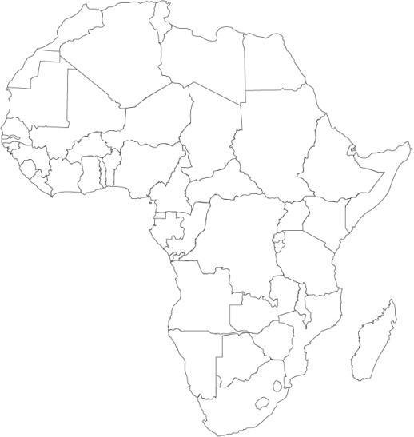
Masters Programme in Taxation: 2009-2011
2009-2011 Students:
The Gambia (1)
Ghana (2)
Lesotho (2)
Malawi (4)
Namibia (1)
Nigeria (6)
Rwanda (1)
Sierra Leone (3)
South Africa (9)
Tanzania (1)
Zambia (3)
Zimbabwe (2)

Slide 9
Masters Programme in Taxation: 2012
2012 (preliminary):
Botswana (1)
Ghana (2)
Malawi (2)
Namibia (1)
Nigeria (2)
Sierra Leone (2)
South Africa (3)
Swaziland (1)
Tanzania (1)
Zambia (3)
Zimbabwe (3)
Total provisionally selected: 21
Entrance examination: results pending

Slide 10


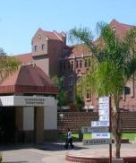
PhD Programme in Tax Policy
The PhD Programme in Tax Policy commences in 2012
It is offered over a three-year period and comprises the following –
  A research proposal (EKN 896)
  A doctoral thesis (EKN 997)
  Three research articles
The formal research component comprises a thesis and three research articles submitted for publication.
The ATI is especially interested to receive draft research proposals in the following areas:
  Fiscal Decentralization and Sub-national Taxation
  Natural Resource Taxation
  Tax Policy and Rural Development
  Using GIS in a Tax Environment
  Taxation and Regional Integration
  Revenue Forecasting and Tax Analysis
A prospective student, who wants to research a topic outside of the above-mentioned research areas, has to submit a comprehensive draft research proposal. Acceptance will depend on the availability of suitable supervision.

Slide 11
PhD Programme in Taxation: 2012
2012:
Ghana (1)
Zimbabwe (2)
Brazil (1)
Total selected: 4

Slide 12

ATI Research
Research fellowships
  Collecting, maintaining and disseminating data on tax issues as these relate to African countries
  Lincoln Institute of Land Policy and ATI Joint Venture on Property Taxation in Africa
    2007-2011: 13 fellows from 11 countries (working in 46 countries)
    2010: Country reports on more than 30 countries
Organise conferences and publish conference proceedings
  Excise Tax Policy + Administration in Southern African Countries (2006) Unisa Press
  VAT in Africa (2008) PULP
Undertake and facilitate contract research and publish research outputs
  E.g. through an All African Tax Journal

Slide 13
2012 ATI Programmes
Post-graduate Programmes
  Masters Programme in Taxation (MPhil: Taxation)
  PhD Programme in Tax Policy
Short Courses
  Business Taxation (February-March 2012)
  Introduction: Tax Analysis & Revenue Forecasting (July 2012)
  Advanced Tax Analysis & Revenue Forecasting (July-August 2012)
  Value-added Taxation (July 2012)
  Excise Taxation (July 2012)
  Fiscal Decentralization and Sub-national Finances (July 2012)
  Natural Resource Taxation (August 2012)
Conferences
  3rd African Tax Forum – 13-15 March 2012, Accra, Ghana (ITIC, ATI, ECOWAS and hopefully ATAF)

Slide 14
Conclusions
Tax is a cornerstone for good governance
Developing capacity and skills levels in the areas of tax policy and tax administration in the public sector is crucial
Universities can and should play an important role
The ATI is committed to this task
  Research
  Postgraduate programmes
  Topical short courses
  Constructive partnerships

Slide 15
CE at UP Course Catalogue 2011/12
CE at UP offers both scheduled open courses and customised in-house training
Summary of all continuing education courses presented by the University of Pretoria across all nine of its faculties
More than 500 short courses catalogues into 20 categories
Short Courses in Financial Science and Economics
  Accounting
  Econometrics
  Economics
  Financial Management
  Forensic Accounting
  General Finance and Tax
  Internal Auditing
  Mathematics
CE at UP website: www.ceatup.com

Slide 16
CE at UP Course Catalogue 2011/12
Accounting
  Introduction to Basic Bookkeeping
Econometrics
  Econometrics for the Practitioner
  Econometric Analysis of Cointegration
  Econometric Analysis of Panel Data
Economics
  Economic Indicators: Monitoring the SA Economy
  Principles of Economics
General Finance and Tax
  Advanced Taxation
  Taxation
  Tax Update Seminar

