Slide 1
Investing in the Northern Cape
Mehmood Ahmed
Regional Manager
Northern Cape
8 October 2010

Slide 2
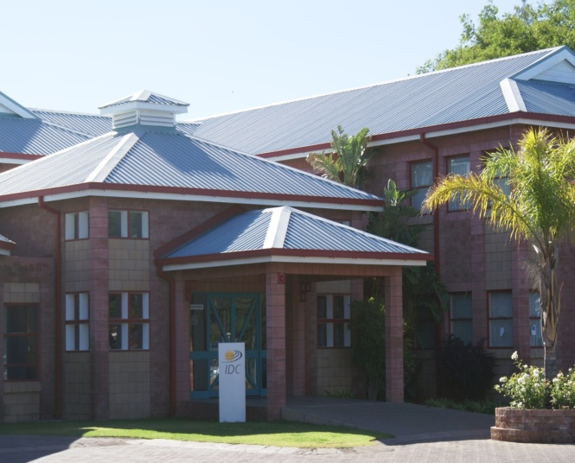
Corporate profile
Established in 1940, the IDC is a self-financing, state-owned development finance institution (70 years old)
Northern Cape Regional Office since 2008
Our mission is to be the primary source of commercially sustainable industrial development and innovation to the benefit of South Africa and the rest of the African continent
Strong capital base developed through years of sound investments – pay taxes & dividends
Aims to maximise developmental and financial returns within an acceptable risk profile
IDC Regional Office, Kimberley
Passion, Partnerships & Professionalism

Slide 3
IDC’s Role
To support sustainable economic growth and development.
The IDC identifies and funds projects through partnerships;
The IDC focuses on promoting and investing in viable new industries; (IPAP II)
The IDC differentiates itself through risk-taking and flexibility in structuring;
the specific needs of the country such as
employment,
rural development
beneficiation
exports

Slide 4
Role of the IDC in the Northern Cape
Strategy for regional development
Proactively identify and support investment opportunities
Improve IDC’s efficiency & accessibility
Convenience (district visits)
Personal attention
Package applications to conform to IDC norms
Involve other stakeholders e.g. Landbank, NEF, DBSA, DoA, Water Affairs
Business Support
Represent all IDC sectors

Slide 5
Financial instruments
IDC offers a wide array of financial instruments, including :
Commercial debt (Loans)
(minimum R1million)
Equity (own shareholding)
Quasi-equity
Share warehousing (BBBEE)
Wholesale & bridging finance
Guarantees
Export/import finance
Short-term trade finance
Venture capital
These may be provided singly or in combination
Flexible deal structuring

Slide 6
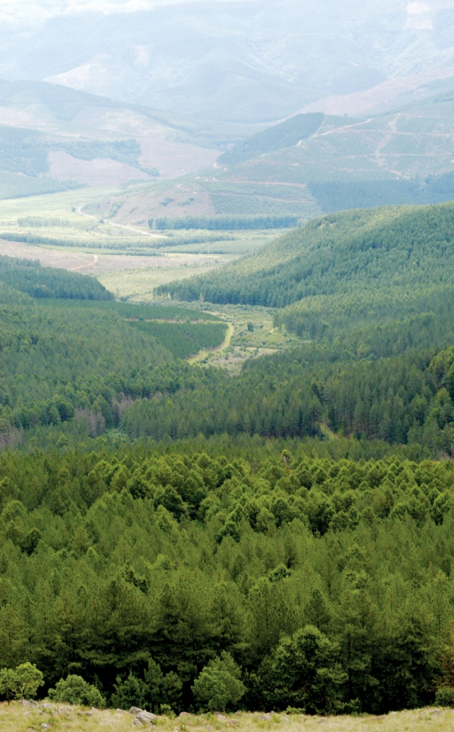
Role in project development
Identifies project opportunities
Co-sponsors feasibility studies
Provides and arranges funding (e.g. export and import finance, equity and loan funding)
Identifies suitable international and local DFIs, commercial and merchant banks and companies and export credit agencies as potential participants
IDC acts as a financial adviser in partnership with other financial institutions
Shares project risk with the sponsors and financial partners
Identifies strong operating partners
Off-take and supply agreements

Slide 7
HIGH DEVELOPMENT RING FENCED FUNDS
Risk Capital Facility-Strategic Business Unit
IDC Business Support Unit
R 1 bn
Annual
Allocation
€47m
Annual
Allocation
R 100m
R 2 bn
R 30m
Various Rm
Transformation and
Entrepreneurial Scheme
(TES)
Support Program for
Industrial Innovation
(SPII)
Risk Capital Facility (RCF)
Clothing & Textiles
Competitive Programme
(CTCP)
Isivande Women’s Fund
(IWF)
Unemployment Insurance Fund
(UIF)
NTSHA TECHNOLOGY VENTURE
CAPITAL FUND
TVC
ADMINISTRATION FUNDS
(ADMIN FUNDS)

Slide 8
TES Structure
TRANSFORMATION AND ENTREPRENEURIAL
SCHEME
R 1 Billion
Women
Entrepreneurial
Fund
R 400 m
40%
Investment: R360m
Bus. Support: R40m
Development
Fund
R 250 m
25%
Investment: R242,5
Bus. Support: R7,5m
Community
Fund
R 150 m
15%
Investment: R145m
Bus. Support: R5m
Equity
Contribution
Fund
R 150 m
15%
Investment: R135m
Bus. Support: R15m
People with
Disabilities
Fund
R 50 m
5%
Investment: R45m
Bus. Support R5m

Slide 10
Sectoral Involvement (continued)
Mining and Beneficiation
Portfolio: R19.9 bn
Approvals: R2 230m
Jobs: 3 000
Clothing, Textiles Leather and Footwear
Portfolio: R1.2 bn
Approvals: R200m
Jobs: 2 500
Chemicals and Allied
Portfolio: R11.2 bn
Approvals: R360m
Jobs: 300
Construction
Portfolio: R1.0 bn
Approvals: R760m
Jobs: 4 500
Transport, Financial and Other Services
Portfolio: R2.8 bn
Approvals: R750m
¹ Exposure as at 30 June 2009 at market values, including commitments
² Value of net approvals 2008/09
³ Number of jobs expected to be created and saved by funding approvals 2008/09
13

Slide 11
Sectoral Involvement (continued)
Tourism
Portfolio: R3.3 bn
Approvals: R710m
Jobs: 1 700
Franchising
Portfolio: R1.0 bn
Approvals: R210m
Jobs: 2 500
Media and Motion Pictures
Portfolio: R1.0 bn
Approvals: R320m
Jobs: 1 900
Techno-Industries
Portfolio: R1.8 bn
Approvals: R740m
Jobs: 3 000
Venture Capital
Portfolio: R0.7 bn
Approvals: R100m
Jobs: 400
Healthcare and Education
Portfolio: R3.1 bn
Approvals: R630m
Jobs: 1 500
Total Exposure R60.5bn as at 30 June 2009 2008/2009 Approvals R10,82 bn
14

Slide 12
Context of green industries
SA one of the higher producers of carbon equivalents
SA lagging behind in carbon credits generation
Leadership role in Copenhagen
Need to lead in implementation
Good sun
Some areas of good wind
Single electricity utility – opportunity and constraint
SA developing country – green technologies expensive
Opportunity to develop new industries – because new internationally, SA can catch up and become leaders
Local production opportunities if we become significant buyers
Low cost of local electricity – sometimes makes greening non-viable
+27(0)82 446 4181

Slide 14
IDC approved projects and current pipeline

Slide 15
IDC role in Green Funding
• IDC direct funding
• Crowding in other funders
• Development of new projects in green arena
• Demonstrating viability of investments – leading the way
• Exploring and accessing international sources of green funding
• Development and utilisation of carbon credits
• Co-ordinating with other agencies

Slide 16
BUSINESS SUPPORT
Technical assistance (TA) for IDC clients to improve business & trust management
Outsourced Consultants, Mentors, Coaches legal experts provide TA
Training courses delivered through IDC Learning & Development (External) Dept. and/or outsourced Training providers (e.g. Institutions, Professional trainers)
Training offered to investee members of the Board of Directors / Trustees, Management Team, middle management, supervisors & staff destined for promotion
Funding principle: Cost sharing between IDC and Client
(The norm is: 50% Grant funding and 50% Client own contribution)
Client own contribution: business cash flow OR a low interest or zero rated loan

Slide 17
BUSINESS SUPPORT
Technical assistance (TA) for IDC clients to improve business & trust management
Outsourced Consultants, Mentors, Coaches legal experts provide TA
Training courses delivered through IDC Learning & Development (External) Dept. and/or outsourced Training providers (e.g. Institutions, Professional trainers)
Training offered to investee members of the Board of Directors / Trustees, Management Team, middle management, supervisors & staff destined for promotion
Funding principle: Cost sharing between IDC and Client
(The norm is: 50% Grant funding and 50% Client own contribution)
Client own contribution: business cash flow OR a low interest or zero rated loan
.… more than funding

Slide 18
Partnerships
COTII
DTI
KHULA
seda
samaf
NEF
OTHER
Provincial Departments
Local Government
NCEDA
DBSA
LANDBANK
LED Structures
Commercial Banks
Business Chambers

Slide 19
Thank you
The Industrial Development Corporation
Sanlam Business Complex
13 Bishops Ave Kimberley P O Box 808, Kimberley, 8300
Telephone (053) 8071050 Facsimile (053) 832 7395
E-mail kimberley@idc.co.za

