Slide 1

Province of KwaZulu-Natal
Provincial Treasury
Welcome

Slide 2
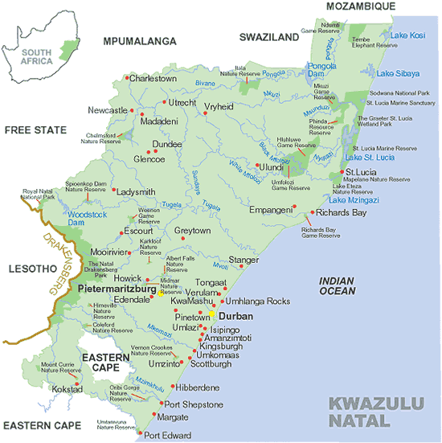

Slide 3
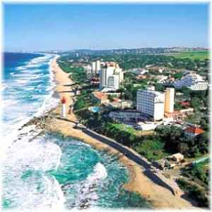

Slide 4
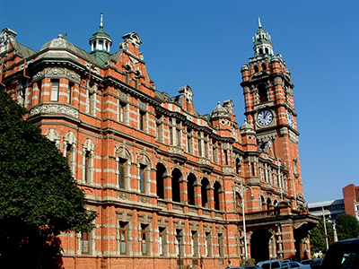

Slide 5
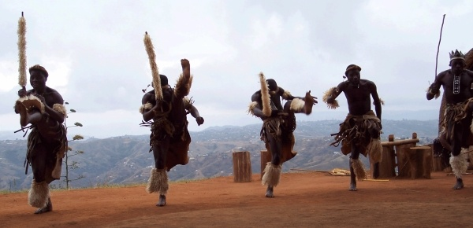

Slide 6
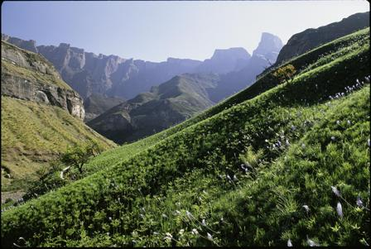

Slide 7
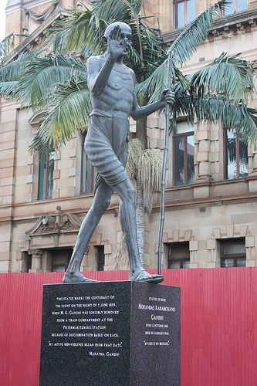

Slide 8

MEC: Ms Ina Cronjé

Slide 9

HOD: Mr LS Magagula

Slide 10
Vision
Be the centre of excellence in financial and fiscal management in the country.
Mission
We, the Provincial Treasury will empower our people through:
an equitable distribution of financial resources, and
strategic leadership in areas of financial and fiscal management and corporate governance.
Core Values
Accountability, efficiency, service excellence, financial discipline, professionalism and sup

Slide 11
SUMMARY OF FINDINGS FOR KZN – 2ND QUARTER 2009
GDPR at constant 2000 prices Non-seasonal adjusted quarter on quarter = 3.73%
GDPR at constant 2000 prices Non-seasonal adjusted quarter on quarter exl agriculture = 0.74%
GDPR at constant 2000 prices Seasonal adjusted quarter on quarter = -1.06%
GDPR at constant 2000 prices Non-seasonal adjusted year on year = -1.43%
GDPR at constant 2000 prices Non-seasonal adjusted year on year exl agriculture = -3.47%

Slide 12
Provincial Sub-Sector | Average Contribution | Difference in Contribution
Agriculture, forestry and fishing | 4.71 | -1.00
Mining and quarrying | 1.48 | -0.58
Manufacturing | 21.90 | -1.32
Electricity, gas and water | 2.42 | -0.54
Construction | 2.48 | 0.78
Wholesale & retail trade; hotels & restaurants | 13.82 | 1.63
Transport , storage and communication | 12.56 | 1.31
Finance, real estate and business services | 15.28 | 1.99
Personal services | 5.50 | -0.32
General government services | 11.08 | -1.59

Slide 13
Provincial Sub-Sector | National Sector Rating | Provincial GDP Rating
Agriculture, forestry and fishing | 1 | 7
Transport , storage and communication | 2 | 4
Manufacturing | 3 | 1
Electricity, gas and water | 4 | 9
Wholesale & retail trade; hotels & restaurants | 5 | 3
Personal services | 6 | 6
Construction | 7 | 8
General government services | 8 | 5
Finance, real estate and business services | 9 | 2
Mining and quarrying | 10 | 10

Slide 14
The Unit has three primary functions
1) Inter-governmental Relations function
Advocacy of IGR principles and protocol and to foster relations between central, regional and local governments, as well as governments between any one sphere (level), that facilitate the attainment of common goals through co-operation.
2) Special projects function
Manage special projects, associated contracts and funds for the department.
3) Economic function
To provide high quality and up-to-date economic and public policy research support and advise to the MEC, the HOD and all public and private stakeholders.

Slide 15
Economic Function
Provide economic support in the form of technical analysis and reports
Conduct public policy research and analysis and develop possible strategies
Conduct high quality economic research and working papers
Communicate through various means with private and public stakeholders about economic trends and behaviour in the province
Deliver Relevant and Related Presentations
Publish Academic Articles
Deliver Papers at National and International Conferences

Slide 16
Publications and Working Papers
Growth in Cities: A KwaZulu-Natal Perspective
The Causes and Consequences of the “Non-Availability” Of Economic Data for Local Economic Development In South Africa: A KwaZulu-Natal Case Study
Trends in the KwaZulu-Natal Economy Derived From Selected Building Statistics of the Private Sector
The KwaZulu-Natal Economy – A Performance Overview
The KwaZulu-Natal Economy – A Structural Overview
The KwaZulu-Natal Economy – A Socio Economic Analysis & Overview

Slide 17
THANK YOU
Clive Coetzee
KZN Treasury
IGR Unit

