Slide 1

Sub-national Macroeconomic Impacts
An alternative approach
Gerhard Bijker, IHS Global Insight
Nov-2011

Slide 2
Background
Regional economists need regional impacts
And therefore they need tools and methodologies to calculate these impacts
Lots of different sophisticated models built on top of the classic Input Output tables
This method uses a National SAM at its heart, and provides a method to distribute the impacts spatially

Slide 3

Social Accounting Matrix (SAM)
A SAM represents flows of all economic transactions that take place within an economy.
It is at the core, a matrix representation of the National Accounts for a given country, but can be extended to include non-national accounting flows, and created for whole regions or area.

Slide 4
South-African Regional SAMs
Different attempts by various people in the past
  Vink, 1996
  IDC, 1997
  van Seventer, 1999
  DBSA Provincial SAMs, 2004-today
Mixed success

Slide 5
Challenges
Inter-regional trade flows
  no solid data
Regional Impacts vs. national impacts
Sector alignments
Cost.... expensive to build a regional SAM
Not the full regional impact
  region modelled as independent “country”

Slide 6




Slide 7


Back to the SAM basics
SAM impact equation:
For any region N:

Slide 8


Two inputs
Structure of the economy:
Shock vector:
Majority of studies attempts to define or refine .

Slide 9




Alternative method
Ignores , uses
Derives for the direct regional impact
Calculates the national impact
Uses the Regional GVA of the economy to derive a regional impact

Slide 10



Equations
Regional shock
vector
Psuedo-national
impact
Regional impact

Slide 11
Direct Impact, shock vector (Xp)
X is “regionalised”.
By making expert assumptions of what of the inputs could be sourced locally (alpha).
This information is very often available, or could be estimated quite easily
This ‘expert knowledge’ is often ignored in calculating regional impacts.

Slide 12


Indirect & Induced impacts
The location-quotient (LQ) method uses
  where the LQ is used as the external information to adjust the AN matrix.
Alternative method very similar, but not on A-level, only on impact-level.

Slide 13



More specific
Assume we have (all national impacts):
  Indirect impact
  Induced impact
Spatial allocation function does have vector beta, where for k=i and h:

Slide 14

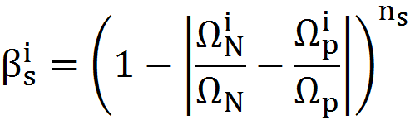
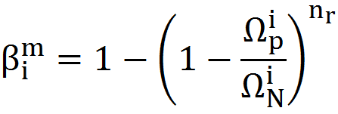
... Beta
For each sector i in the economy, we have two factors:
  s: Structural of the economy (similar to LQ)
  m: Critical Size - to supply in the demand

Slide 15

KNOW

Slide 16
Results
Similar to DBSA provincial SAMs
Method very new
  not widely applied yet
  limited results available
Could be applied to ANY region / location, without spending money to building a region-specific SAM
Based on the better quality national SAM

Slide 17
Example

Slide 18
Limitations
Types of shocks is limited
This methods outputs the regional industry impact only (the various economic sectors)
Non-sector, social variables could be “regionalised” by assuming relationships between the industries and the corresponding non-industry variables.
  Future extension – adding external social data
  Region-specific labour multipliers;
  Region-specific household income data; etc.

Slide 19

KNOW

Slide 20
Questions?

