Slide 1

IHS Industry & Insight
Henk Gnade
012 665 5420
29 November 2011

Slide 2

Who is IHS?
  In business since 1959, we are a leading global source
  of information and expert analysis in pivotal areas shaping today’s global business landscape.
  Revenue in excess of $1.250 billion at fin-year-end 2011
  IHS customers include nearly 70% of the US Fortune 1000
  IHS customers include 80% of the Global Fortune 500
  5,000 IHS colleagues in over 30 countries speaking more than 40 languages

Slide 3
IHS Industry and Insight - Centurion
  REGIONAL EXPLORER
    Accurate and up to date demographic, economic & socio-economic and information for the municipalities and provinces in SA
  ECONOINSIGHT
    Economic forecasts and analyses spanning the short, medium and long-term prospects for SA and the world
  ECONOSTAT
    Web based data delivery interface providing up to date economic information
  ADVISORY SERVICES
    Combines one of the largest repositories of economic information with a team of experienced business and economic analysts
  TRAINING
  Various workshops : Regional economics, spreadsheet applications & modeling techniques

Slide 4
IHS Regional eXplorer
Industry Specific Indicators
related to output
Sectoral & Structural Trends
and Indicators
National Accounts
Economic Module
Econometric Sectoral Model
Global Economy
Commodity Trends
International Trade
Urbanisation
Household Income
Unemployment
Poverty
Development Module
Income
Module
Labour Module
Absorption
Retail Sales
Education
Skill Levels
Remuneration
Literacy
Consumption
Formal / Informal
Employment
HIV
Demographic Module
Cohort Component Model
Life expectancy
Fertility
Age distribution
Migration
Mortality
Notes:
The model part 1

Slide 5
IHS Regional eXplorer
IHS Regional eXplorer
Industry Specific Indicators
related to output
Sectoral & Structural Trends
and Indicators
National Accounts
Economic Module
Econometric Sectoral Model
Global Economy
Commodity Trends
International Trade
Formal Housing
Hotel Distribution
Urbanization
Unemployment
Sanitation
Household Infrastructure
Development Module
Tourism Sector Module
Foreign Tourists
Poverty
Income
Module
Labour Module
Absorption
Water
Domestic Tourists
Education
Remuneration
Types of Tourism
Refuse
Literacy
Formal / Informal
Employment
Electricity Connections
Tourism Satellite Account
HIV
Demographic Module
Cohort Component Model
Life expectancy
Fertility
Age distribution
Migration
Mortality
Notes:
The model part 2
The balancing equation

Slide 6
ReX Improvements 2011
  Household Infrastructure module
  Tourism module
  Updated to 2011 boundaries
  Various improvements to the population model
Notes:
This is like a ‘contents’ slide.
We’ll go through each of these with some examples (charts, etc.) displaying each improvement

Slide 7
Household Infrastructure
Notes:
Household Infrastructure model now includes all five infrastructure measures (refuse, sanitation, water, housing, electricity)
This chart shows that Mpumulanga
Is worse than the SA average in provision of housing, sanitation and refuse
Is better than the SA average in provision of electricity

Slide 8
Household Infrastructure

Slide 9
Household Infrastructure
Notes:
The infrastructure index now also considers all five infrastructure measures (housing, sanitation, refuse, water and electricity)

Slide 10
Household Infrastructure
Notes:
Infrastructure index compared across provinces
Most developed – Western Cape and Gauteng
Least developed – Eastern Cape and Limpopo

Slide 11
Tourism Model
  Newest introduction to the ReX suite of models
  Includes the following for each municipality:
    Trips made to municipalities
    Bednights spent in each municipalities
    Type of trips made to each municipalities
    Origin of tourist (foreign / local)
    Total tourist spend per municipalities as final destination
Notes:
What does the new tourism module contain

Slide 12
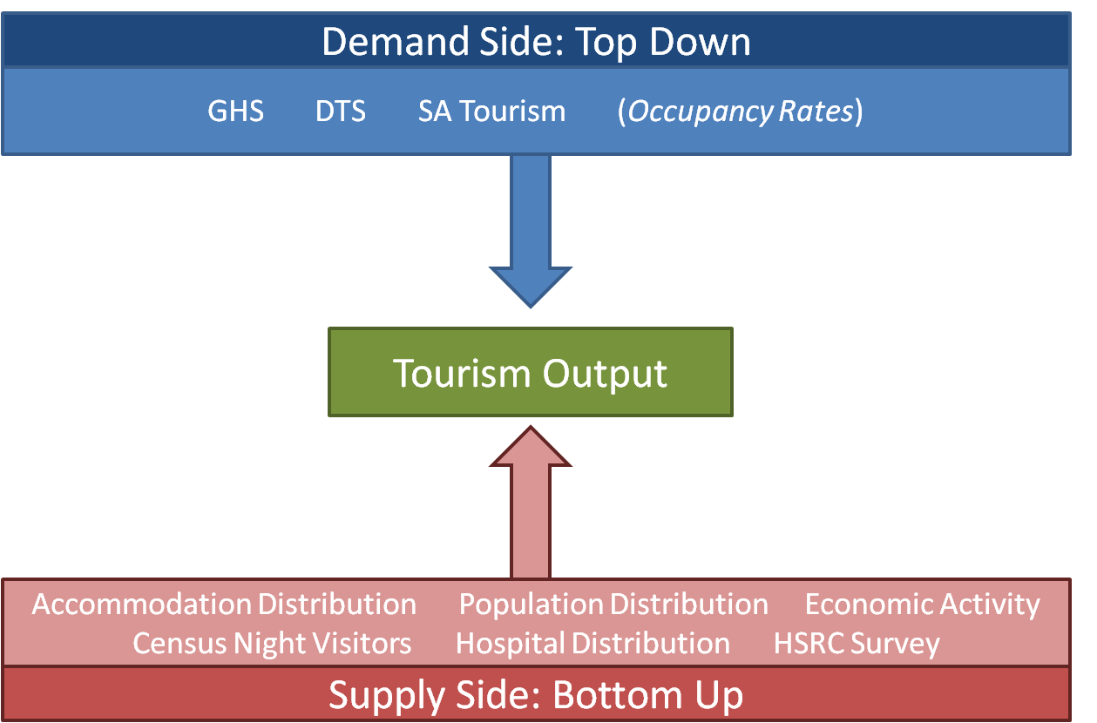
Tourism Model
Notes:
Very broad overview of how we calculated the trips and bed nights output
Basically, we had a few provincial estimates (blue block)
We combined this with data sources from the low level (red block)
We balanced these in the middle to come up with the Tourism Output

Slide 13
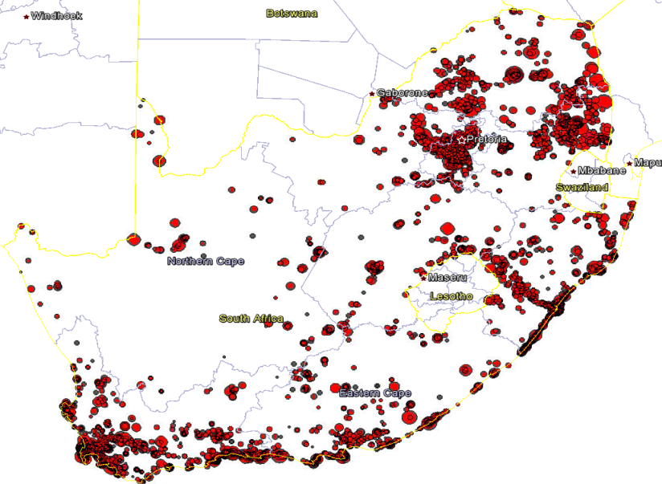
Tourism Model
Notes:
This distribution of accommodation (weighted by number of rooms available) helped make the new module possible

Slide 14
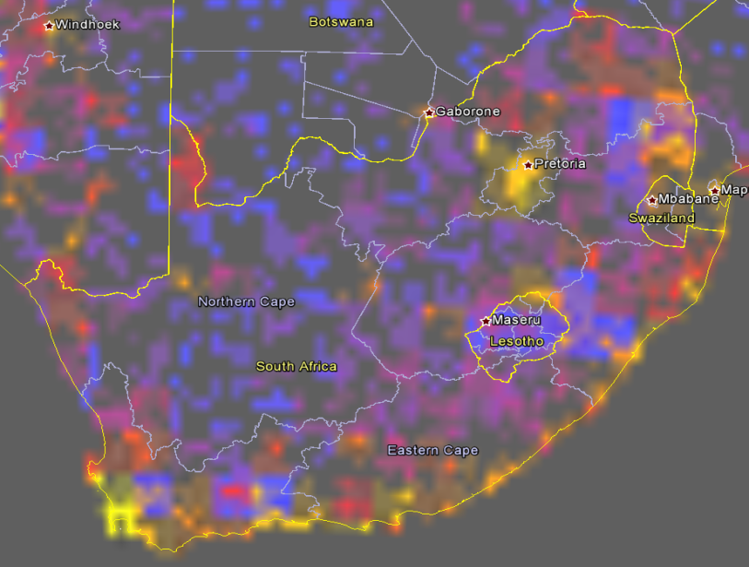
Tourism Model
Notes:
Our hotel distribution compared well with photographs uploaded to Panoramio

Slide 15
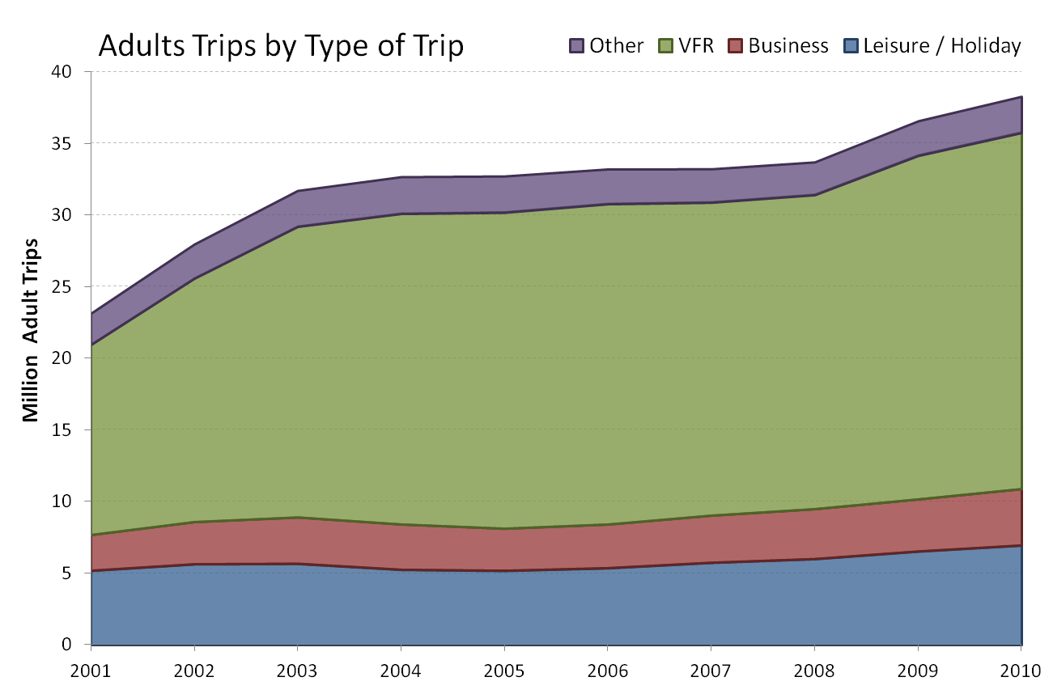
Tourism Model
Notes:
Next few slides show example data from our tourism model.
This is the number of TRIPS - national level
:: Tourism is dominated by people visiting their friends and relatives

Slide 16
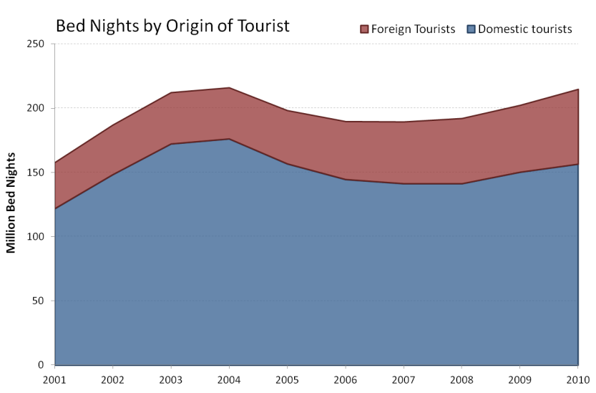
Tourism Model
Notes:
This is the number of bed nights - national level
:: Tourism market is dominated by domestic tourists

Slide 17
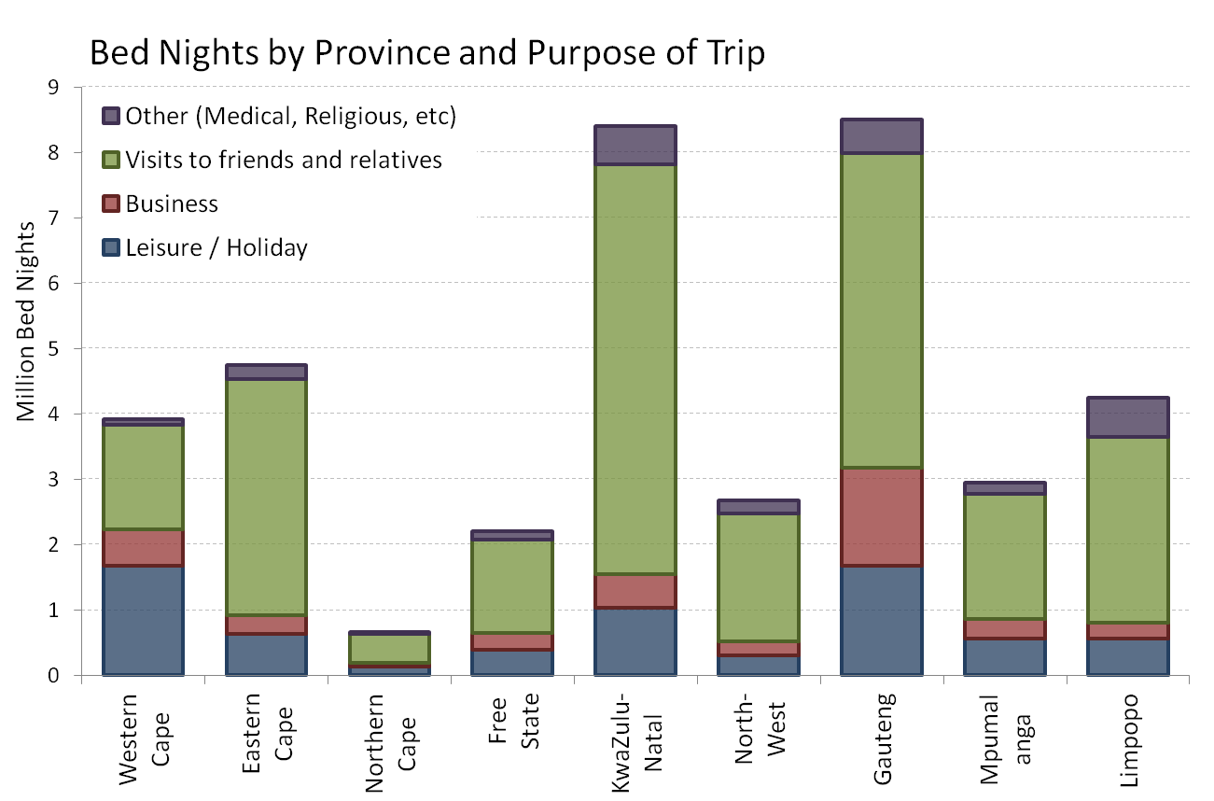
Tourism Model
Notes:
KZN and Gauteng receive the most tourists overall
Western Cape gets the highest share of leisure trips
KZN, EC, LP get the highest amount of VFR visits – these are all rural areas with lots of out migration, therefore lots of visitors returning home

Slide 18
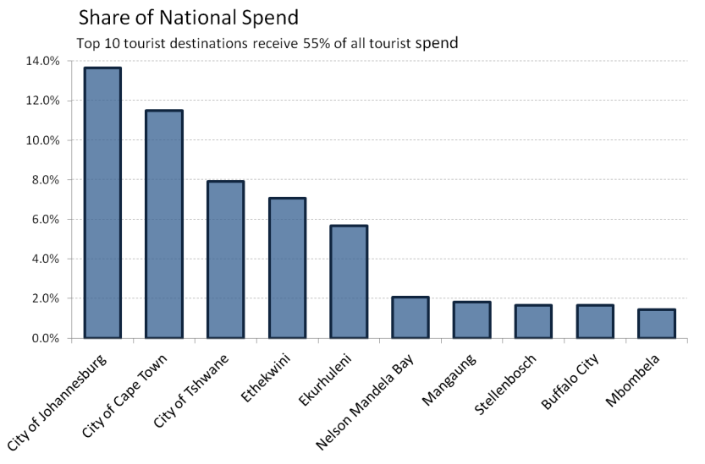
Tourism Model
Notes:
Regions that receive the most total tourism spend (top 10 receive 55% of national tourism spend.)

Slide 19
2011 Boundary Changes
  Major Boundary Changes for 2011:
    Two new metropolitans
      Buffalo City (East London area)
      Mangaung (Bloemfontein area)
    Major demarcation changes
      All District Management Areas added to existing Municipalities
      Various combinations (e.g. Tshwane and Metsweding combined)
      Various border changes
Notes:
Next few slides will give examples of the important ‘Major Demarcation Changes’
Pixley Ka Isaka Seme - Dr Pixley Ka Isaka Seme (Gazette no 211 of 2010), Tembisile - Tembisile Hani & Albert Luthuli - Chief Albert Luthuli

Slide 20
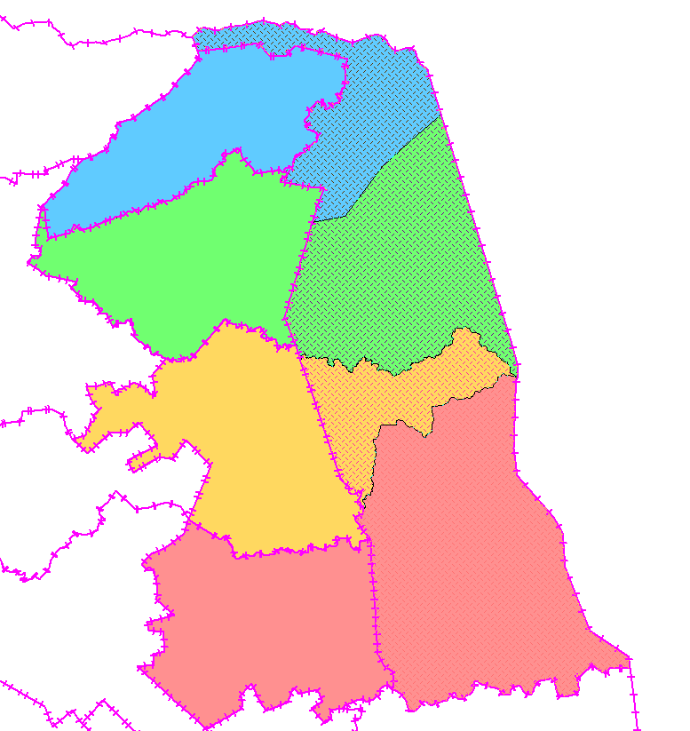
2011 Boundary Changes
  All District Management Areas
    Folded into local municipalities
Example:
Kruger park divided among
  Mutale
  Thulamela
  Greater Giyani
  Ba-Phalaborwa

Slide 21
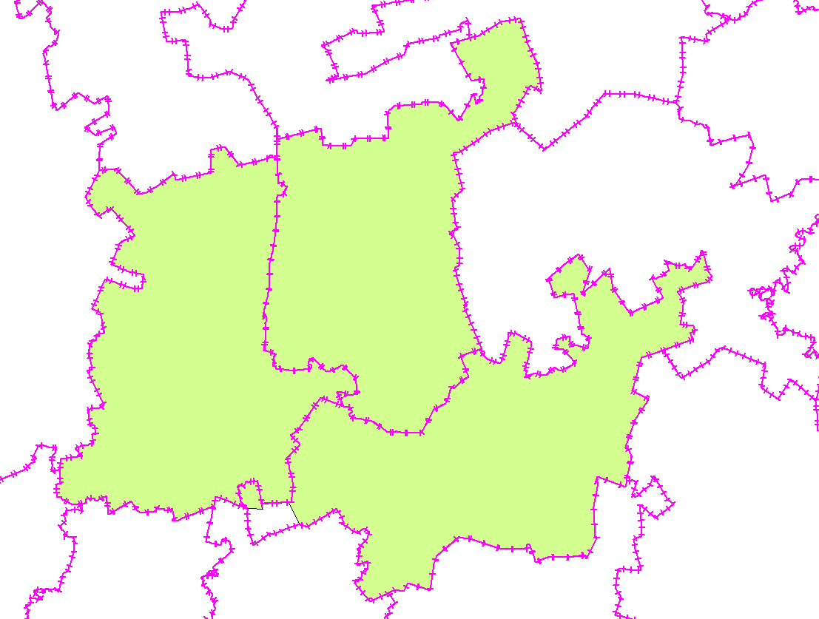
2011 Boundary Changes
  Combinations (e.g. Tshwane and Metsweding)
Nokeng Tsa Taemane
Tshwane
Kungwini

Slide 22
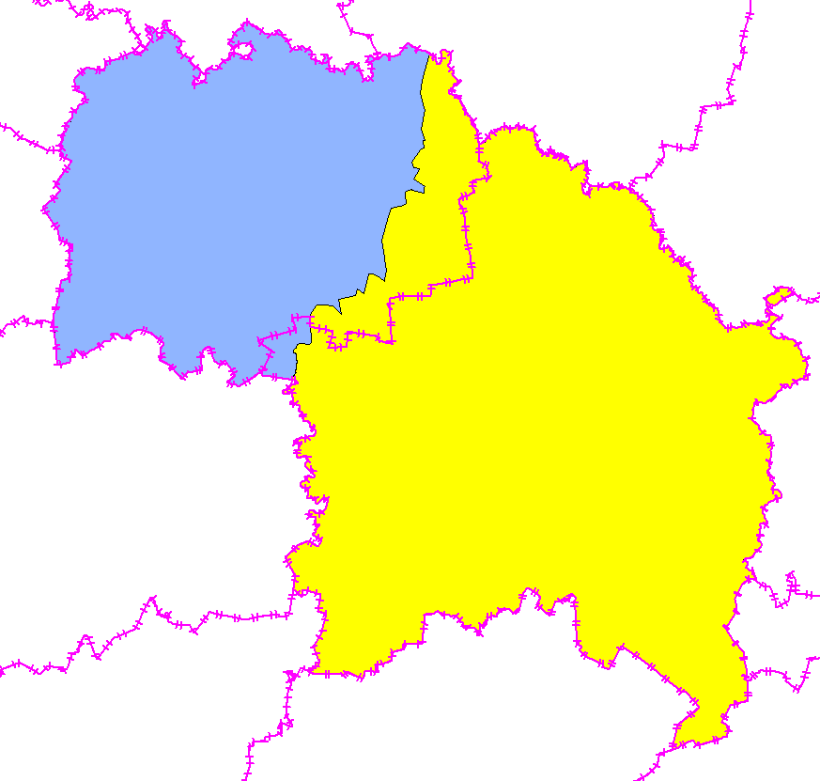
2011 Boundary Changes
  Boundary Change
Mafube
Example:
Phumelela and Mafube
in the Free State
Phumelela
Old Boundary
New Boundary

Slide 23
2011 Boundary Changes
  ReX Now Caters for the Following Boundary Sets:
    Magisterial Districts (1996 boundaries)
    Municipalities on the 2005 boundaries
    Municipalities on the 2011 boundaries
    Custom boundaries created from any of the above

Slide 24
Improvements to the Population Model
  Updated to include the following:
    Latest antenatal clinic data
    ARVs shown to be more effective than previously thought
    Various cause of deaths reports
    ASSA 2008 results and improvements
    Number of small methodological fixes and improvements
Notes:
Last big change made to ReX this year was the population model
ASSA = Actuarial Society of South Africa
Result – Higher population than expected, because ARVs are more effective than everyone thought at the time

Slide 25
What to expect in 2012?
  The same, high level of service and access to analysts
  Methodology document is being rewritten in order to be
    More open
    More accessible
    Easier to read and search
  Fully featured help centre, including maps and region details
  More polishing and refining of the model base
  A new module? Maybe?
    What would you (the PSEF) find useful?
Notes:
Last big change made to ReX this year was the population model
ASSA = Actuarial Society of South Africa

Slide 26
  What would you (the PSEF) find useful?
Notes:
Last big change made to ReX this year was the population model
ASSA = Actuarial Society of South Africa

