Slide 1
The impact of the global meltdown on banking regulation and supervision
Jaco Mostert
Northern Cape Dept of Econ Dev and Tourism

Slide 2
Overview
Introduction
Historical overview
Overview Basel III proposals
Critical evaluation of Basel III proposal
Conclusion
Questions

Slide 3
Introduction
Basel I- one-size-fits-all
Basel II- risk based. Banks able to use own risk models
How will Basel II perform in global crisis?
Crisis highlighted- too-big-to-fail, moral hazard and the role of regulators
Basel III – definition of capital, liquidity proposals

Slide 4
Historical overview
First need to look at limitations in Basel I and II to be addressed in Basel III
Basel I – soundness and stability, consistency
Basel I- only credit risk, four risk buckets, solvency level
Allen- levelled playing field will improve the efficiency, safety and soundness of the global financial system
Basel II- Internal models and operational risk
Critique- Mostert (2003) Use of credit ratings
Will Basel II avoid banking crisis?

Slide 5
Basel III proposals

Slide 6
Capital adequacy of banks
Improve quality and quantity of capital
Deals with systemic risks like procyclicality and interconnectedness of banks

Slide 7
Liquidity of banks
Recent crisis showed that liquidity is as important as capital for banking system stability
Tarullo (2011) doubt about capital caused liquidity crisis.
Liquidity cover ratio – liquidity stress one month – p8
Net Stable Funding ratio
Limits reliance of short term wholesale funding –especially during times of buoyant market liquidity

Slide 8
Critical evaluation of the Basel III proposals

Slide 9
Importance of banking sector to avoid crises
Walters (2011:1) losses of economic output to about 60% of pre crisis GDP
Also the important role that banks play in the financial intermediation process
Increase debt-to-GDP ratio by 10-25%
Mostert (2003) stable financial systems leads to higher economic growth

Slide 10
The regulatory burden of Basel III
Walters (2011:2) BCBS long term impact assessment- positive impact
Angelini- 0,09% decline due to capital requirement , 0,08% liquidity proposals

Slide 11
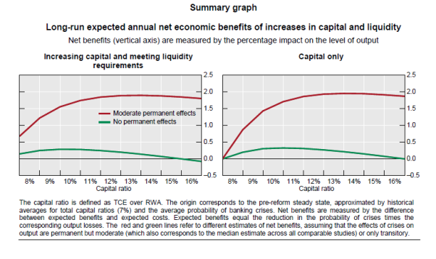

Slide 12
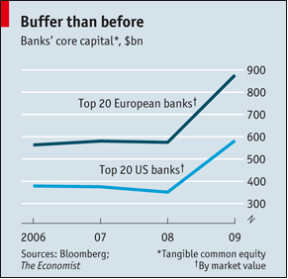

Slide 13
Quality of capital
Wellink – support proposal. More stringent requirements will limit risk taking by banks

Slide 14
Leverage ratio
Tier 1 capital as % of assets
Hannoun – will address systemic risks in the system
Walter – clear discriminator between failing banks and banks requiring assistance
Low risks exposures in one bank can lead to concerns in broader system
The importance of the leverage ratio can be deducted from ratio between build up in assets vs risk based asset before the crisis.

Slide 15
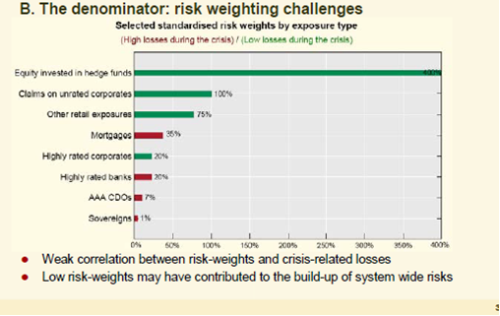
Trading book and securitations
Hannoun – major losses in 2007-2009 crisis on trading book and especially securitisations

Slide 16
Capital conservation
Expect that banks will build capital buffers during times of growth to have it available during crisis times
Banks continued to pay dividends, bonuses to shareholders and workers and other capital contributors instead of conserving capital
2,5% buffer of risk-weighted assets to be held in common equity capital
Regulators can force restrictions of distributable items like dividends, bonuses

Slide 17
Systemic risk capture in risk model
Joint forum (2010) study –risk aggregation in internal models will perform adequately in varying circumstances, like in recent crisis.
Models not used for intended purpose
Caution against models p21
Hannoun- supervision to be more intrusive to ensure that systematic risk and tail events are captured in the banks’ models and stress testing

Slide 18
Regulatory impact
ABSA – R300 million
Worries about the availability of enough liquid assets in the market
Economist - $ 1,6 trillion in Europe
Barclays capital estimated 16% loss in profit due to domestic legislation

Slide 19
Calibration
Wellink- liquidity framework will be properly calibrated with data collection
Issue not discussed in literature

Slide 20
Role of central banks in Liquidity crisis
Cao and Iling – Short run support to solvent banks can lead to moral hazard. Provide to market not individual banks
Buiter and Sibert – central bank should provide liquidity because they can create it at any stage
Walters- will lead to greater diversification of pool of liquid assets. Currently mainly exposures to sovereigns, central banks and zero percent risk weighted public entities. Basel III also corporate and covered bonds

Slide 21
Implementation of proposals
Implemented rigorously and consistently across jurisdictions
Enforced by supervisors
Internal risk based model complicates implementation
Could lead to race to the bottom
Cooperation and coordination between supervisors

Slide 22
Conclusion
Recent crisis highlighted issue of correct amount and type of capital
Liquidity requirement will be difficult to implement

