Slide 1
The impact of basic and social infrastructure investment on inequality in South Africa
28 November 2013
Henk Gnade
012 662 9664

Slide 2
BACKGROUND:
Numerous aimed to improve quality of life and promote economic and social transformation have been launched since 1994, major programs include:
  Reconstruction and Development Programme (RDP) - 1994
  Growth Employment and Redistribution (GEAR) - 1996
  Accelerated and Shared Growth Initiative of South Africa (ASGISA) – 2006
  New Growth Path (NGP) - 2010
Achieving mixed levels of success with high levels of poverty and inequality still persisting
National Planning Commission (NPC) was the tasked to determine a vision of what South Africa should look like in 2030 and how it could be achieved. A growth diagnostic was released (2011) and identified 9 challenges In to alleviating poverty and reducing inequality:
  Poor education outcomes
  High disease burden – health system cannot meet demand and sustain quality
  Divided community
  Uneven public service performance (often of poor quality)
  Divided spatial patterns hampering inclusive development
  Low employment levels
  Corruption
  Resource-intensive economy unsustainable
  Infrastructure poorly located, inadequate and crumbling infrastructure
The diagnostic overview indicated that the challenges regarding poverty and inequality are more severe in rural areas and municipalities.
  The National Development Plan (NDP) - 2012

Slide 3
SIGNIFICANCE OF RESEARCH:
The impact of selected infrastructure services on growth and development has been well researched internationally:
  It shows a strong relationship between investment in infrastructure and growth (causality concerns)
  The exact impact on poverty and inequality remains elusive – consensus is that, under the right conditions, investment in basic infrastructure does contribute to reducing inequality and poverty (Calderón & Servén 2008:1)
The effects of infrastructure Investment in rural and urban municipalities are largely understudied
  Unavailability of comparative data (Bogetic & Fedderke, 2005:12; Svendson, 2009:25).
  Information on the effect of infrastructure reforms on poor citizens, who typically live in rural areas, is limited as a result of the lack of consistent data (Jerome & Ariyo (2004:39)
Some notable data restrictions or omissions include:
  Identification, measurement and heterogeneity
  Empirical analysis on the impact of infrastructure on rural and urban areas respectively
  Empirical analysis on the collective impact of infrastructure investment (the impact on rural and urban areas being absent) – (Calderón & Servén, 2008:7)
The respective impact on urban and rural infrastructure investment could assist policy makers and planners to:
  Prioritise basic and social infrastructure delivery (most deprived, greatest number of people reached etc.)
  Optimize social returns of basic infrastructure investment given limited resources and funds

Slide 4
Calderón & Servén (2004:26) suggest that infrastructure investment should be the poverty and inequality reduction policy.
Lopez (2003:13) argue that public infrastructure investment would yield an increase in economic growth in addition to reducing poverty.
Both Lopez (2004:17) and Calderón & Servén (2004:26) indicate that infrastructure investment would benefit the poor more than proportionally.

Slide 5
CONCEPTUAL FRAMEWORK:
Note: The conceptual framework indicated the number of connections and linkages that will be discussed in the literature review. The fact that certain connections are omitted or not discussed does suggest that they do not exist.

Slide 6
LITERATURE REVIEW:
INDICATOR |  | BINF | Elasticity
 |  |  | GDPPC | HHDINC | HDI | PERPOV | PERLIT
I M P A C T | GDPPC | Aschauer 1989 (0.24) Snieska & Simkunaite, 2009 Fedderke, Perkins & Luiz 2006 (0.15 – 0.39) Rodrigues 2006 (0.08 – 0.14) Briceño-Garmendia & Foster 2009 (0.14 – 1.12) |  | 0.14 – 1.12 - - -0.17 - 0.20* |  | -0.53 – 1.22* -1.3 -3.9 -1.37 | 0.09 – 0.25 - 0.5
 | HHDINC | Komives et al. 2001 Estache et al. 2002 Frühling 2010 Brenneman & Kerf 2002 | Briceño-Garmendia et al. 2004 |  | 0.5-0.6 | - - 0.5
 | HDI | Brenneman & Kerf 2002 Calderon & Serven 2004 Kusharjanto & Kim 2011 |  | Viscussi & Aldy 2003 Ravallion 2010
 | PERPOV | Calderón & Servén 2008 Bogetic & Fedderke, 2005 De la Fuente & Estache 2004 Jalilian & Weiss 2004 (0.35 – 0.52) | Ram 2006 Bhorat & v/d Westhuizen 2005 Lopez 2003 Miranti, et al 2013 | Estache 2002 Sanchez & Sbrana 2009 Seethepalli et al. 2008 Radhakrishna & Panda 2006 |  |  | 0.14 & 0.16% point decr in pov in urban & rural areas
 | PERLIT | Calderon & Serven 2004 Leipziger et al. 2003 Bond 1998 | Sadequl 2013 Sanchez & Sbrana 2009 Coulombe, Tremblay, & Marchand 2004 | Estache et al 2002 Alesina & Perotti 1995 Brenneman & Kerf 2002 |  | Estache et al., 2002 Hoogeveen & Özler 2009 Seethepalli et al. 2008
Notes:
Rodrigues 2006 US only
Infrastructure for Economic Development and Poverty Reduction in Africa
Jalilian and Weiss (2004) explore the nexus between infrastructure, growth and poverty using samples of countries from Africa, Asia and Latin America. applying different theoretical and empirical techniques, they obtain results from the estimation of the ‘ad hoc model’ showing that on average, a one per cent increase in infrastructure stock per capita, holding human capital constant, is associated with a 0.35 per cent reduction in the poverty ratio, when poverty is measured by USD 1/day poverty headcount, or 0.52 per cent when it is measured by USD 2/day poverty headcount.
Bhorat and van der Westhuizen: We first examine the poverty-mean income (or in this case expenditure) elasticies. In 1995, using the R322 a month poverty line, a one percent increase
Brenneman and Kerf (2002) in mean expenditure would reduce the poverty gap by about one percent. By 2005, this elasticity has increased to 1,3 percent, meaning that a one percent increase in mean per capita expenditure would lead to a larger reduction in the poverty gap
Calderon 2009 increasing infrastructure stocks in all three sectors may lead to a growth per capita increase of at least 2 percentage points in East African countries, (d) an analogous result holds for countries in the Southern African region with the exception of Mauritius and South Africa.
Lopez 2003For example, Table 1 presents the theoretical elasticities of headcount poverty to growth and headcount poverty to inequality computed under the assumption that the income distribution can be approximated by a long-normal density function
- Table 3 that the elasticity of poverty with respect to GDP per capita declined in absolute values, i.e. from21.50 for 1980–99 to
21.08 for 2000–06. For the full period, the elasticity is 21.28.
Ram 2006:
A review of the evidence by Viscussi and Aldy (2003) concludes that the income elasticity is in
the range 0.5-0.6.

Slide 7

METHODOLOGY:
The basic infrastructure stock index, was calculated using the Principal Components Analysis (PCA) method (Theil, 1971).
The estimated basic infrastructure index, at the first principal component, was calculated as follows:
The constructed synthetic basic infrastructure index are used along with an urban-rural intercept and slope dummy using Least Square Dummy Variable (LSDV) regression in order to account for heterogeneity in the data.
Using restricted and unrestricted regression techniques will determine whether the relationship between basic infrastructure and the growth and development indicators are statistically different in rural and urban municipalities.
The general model are specified as:

Slide 8
RESULTS:
VARIABLE | C | BINF | RUDUM | BINFRU | R2 Adj | F-Stat
LGDPPC | 9.608 | 0.361 | 0.387 | -0.035 | 0.600 | 1989.512
 |  | 62.791* | 13.761* | -1.707*
 |  | (0.000) | (0.000) | (0.088) |  | (0.000)
LHHDINC | 10.894 | 0.211 | 0.105 | 0.078 | 0.516 | 1413.521
 |  | 52.018* | 5.268* | 5.431*
 |  | (0.000) | (0.000) | (0.000) |  | (0.000)
LPERPOV | -0.690 | -0.129 | -0.118 | -0.075 | 0.604 | 2024.953
 |  | -56.727* | -10.590* | -9.278*
 |  | (0.000) | (0.000) | (0.000) |  | (0.000)
LHDI | -0.702 | 0.091 | 0.092 |  | 0.729 | 5353.749
 |  | 86.773* | 23.013*
 |  | (0.000) | (0.000) |  |  | (0.000)
LPERLIT | -0.603 | 0.099 | 0.173 |  | 0.698 | 4595.549
 |  | 72.902* | 33.321*
 |  | (0.000) | (0.000) |  |  | (0.000)
* T-Statistic
** R-Square
(..) Probability

Slide 9
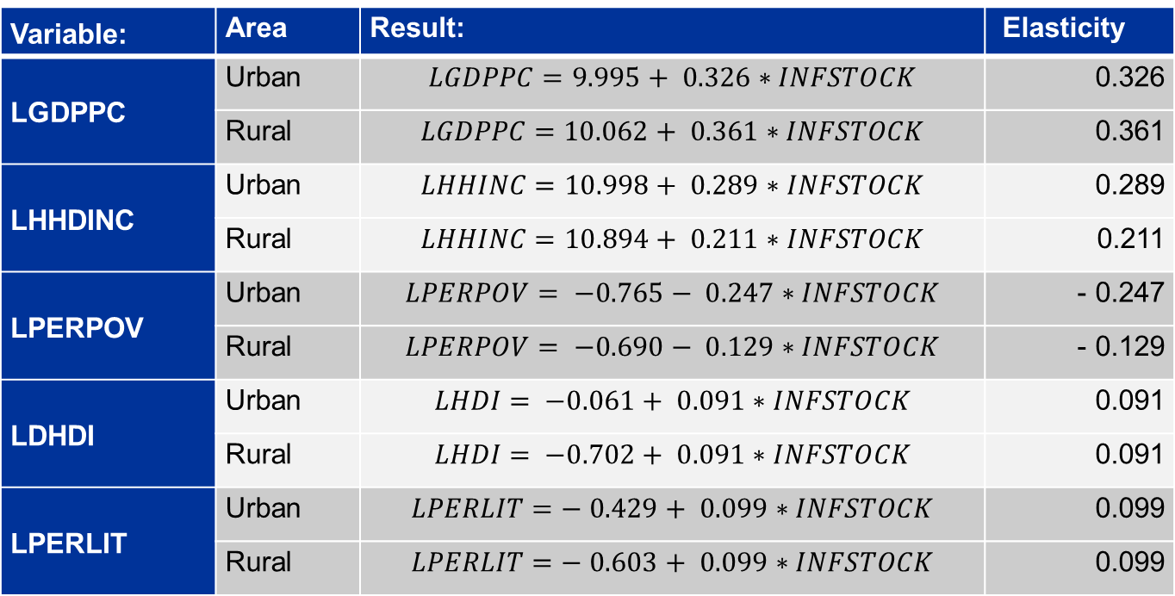
RESULTS: Basic Infrastructure
Variable: | Area | Result: | Elasticity
LGDPPC | Urban | $$LGDPPC=9.995+ 0.326∗INFSTOCK$$ | 0.326
 | Rural | $$LGDPPC=10.062+ 0.361∗INFSTOCK$$ | 0.361
LHHDINC | Urban | $$LHHINC=10.998+ 0.289∗INFSTOCK$$ | 0.289
 | Rural | $$LHHINC=10.894+ 0.211∗INFSTOCK$$ | 0.211
LPERPOV | Urban | $$LPERPOV= −0.765− 0.247∗INFSTOCK$$ | - 0.247
 | Rural | $$LPERPOV= −0.690− 0.129∗INFSTOCK$$ | - 0.129
LDHDI | Urban | $$LHDI= −0.061+ 0.091∗INFSTOCK$$ | 0.091
 | Rural | $$LHDI= −0.702+ 0.091∗INFSTOCK$$ | 0.091
LPERLIT | Urban | $$LPERLIT=− 0.429+ 0.099∗INFSTOCK$$ | 0.099
 | Rural | $$LPERLIT=− 0.603+ 0.099∗INFSTOCK$$ | 0.099

Slide 10
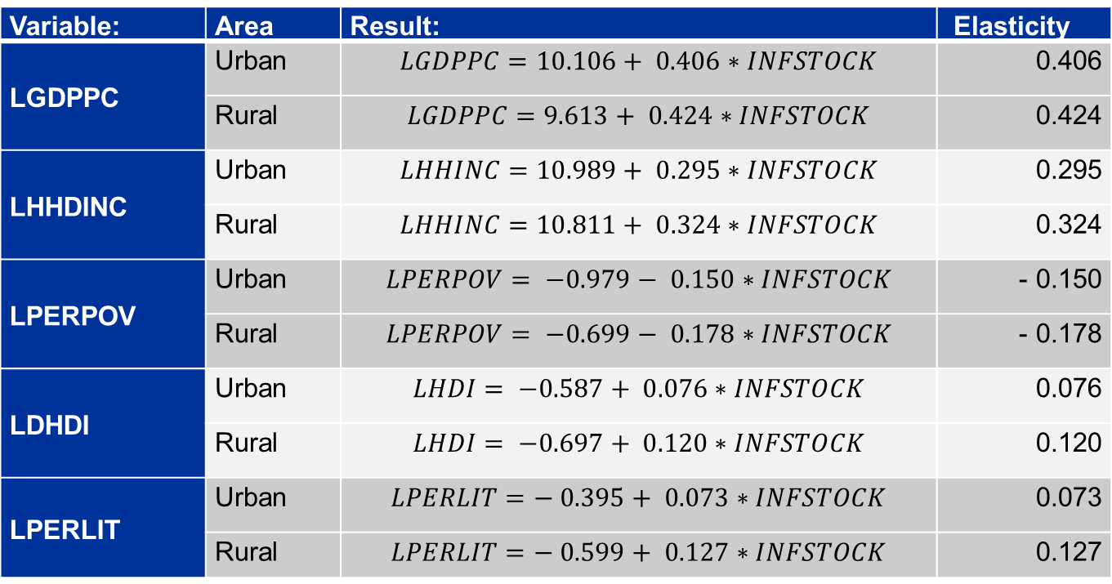
PRELIMINARY RESULTS: Social Infrastructure
Variable: | Area | Result: | Elasticity
LGDPPC | Urban | $$LGDPPC=10.106+ 0.406∗INFSTOCK$$ | 0.406
 | Rural | $$LGDPPC=9.613+ 0.424∗INFSTOCK$$ | 0.424
LHHDINC | Urban | $$LHHINC=10.989+ 0.295∗INFSTOCK$$ | 0.295
 | Rural | $$LHHINC=10.811+ 0.324∗INFSTOCK$$ | 0.324
LPERPOV | Urban | $$LPERPOV= −0.979− 0.150∗INFSTOCK$$ | - 0.150
 | Rural | $$LPERPOV= −0.699− 0.178∗INFSTOCK$$ | - 0.178
LDHDI | Urban | $$LHDI= −0.587+ 0.076∗INFSTOCK$$ | 0.076
 | Rural | $$LHDI= −0.697+ 0.120∗INFSTOCK$$ | 0.120
LPERLIT | Urban | $$LPERLIT=− 0.395+ 0.073∗INFSTOCK$$ | 0.073
 | Rural | $$LPERLIT=− 0.599+ 0.127∗INFSTOCK$$ | 0.127

Slide 11
CONCLUSION:
The empirical results support the broad view that basic infrastructure investment would have a positive influence on growth, poverty and inequality
Anecdotal indications in the reviewed literature suggested that the impact on growth, poverty and inequality be greater in rural as opposed to urban municipalities. The results are however mixed:
  Basic Infrastructure has a greater impact on GDP per capita in rural municipalities
  Increased basic infrastructure has a greater impact on urban poverty rates and disposable income
  Basic Infrastructure increases would have a similar impact in both urban and rural HDI and literacy rates
While the initial results are somewhat ambiguous, they do make a number of important points:
  Basic infrastructure impact urban and rural municipalities differently on a number of factors
  Even when impacts are similar, urban municipalities are more deprived and in greater need of basic infrastructure services
  Limited funds and resources may necessitate prioritising between investing for the benefit of the most deprived citizens or reaching the largest number of beneficiaries

Slide 12
APPENDICES

Slide 13
DATA:
Variable: | Description: | Sources:
HH | Number of households | Census, 1991, 1996, 2001, & 2011, CS 2007, STATSSA Tourism & Migration (various), UNHCR 2000. ASSA2000, 2001 & 2002.
WATER | Households with piped water at or above RDP-level | Water Services National Information System - (WS NIS), STATSSA: The real estate and business services industry, Non-Financial Census of Municipalities, Census, 1991, 1996, 2001 & 2011, CS 2007.
ELEC | Households with electricity connections | DPME, Annual Report (Various), Eskom Annual Report (Various), NERSA, Electricity Supply Statistics, STATSSA: The real estate and business services industry, STATSSA: Non-Financial Census of Municipalities, OHS ,1995 – 1999, GHS, 2008 to current, Census, 1991, 1996, 2001 & 2011, CS 2007.
SAN | Number of households with hygienic toilets | STATSSA: The real estate and business services industry, Water Services National Information System - (WS NIS), Census, 1991, 1996, 2001 & 2011, CS 2007.
GDPPC | Gross Domestic Product per capita (GDPPC) is equal to the GDP of a region divided by the population of that region | ABSA, CNCI, MIBU, DME, STATSSA, NAAMSA, National Accounts, SAPIA ,SEIFSA etc.
HHDINC | Household disposable income the total income of the household after taxes – constant prices | IES, 1995, 2000, 2005/6. LFS, 2000 to current, OHS ,1995 – 1999, QLFS, 2008 to current, GHS, 2008 to current, BMR Report no. 299. SARB: National Accounts, & Final consumption expenditure by households, 1996 to current., STATSSA report-04-03-02: Final social accounting matrix. Census, 1991, 1996, 2001 & 2011, CS 2007.
HDI | Human Development Index | SALDRU, 1994, BMR Various, Census, 1991, 1996, 2001 & 2011, CS 2007

Slide 14
DATA:
Variable: | Description: | Sources:
PERPOV | Minimum monthly income needed to sustain a household and varies according to the size of that HH | Minimum Living Levels from BMR (Various), Census, 1991, 1996, 2001 & 2011, CS 2007.
PERLIT | Population aged 20+ who have completed grade 7 | Census, 1991, 1996, 2001 & 2011, CS 2007.
Urban municipalities | A – Metropolitan municipalities, large urban complexes with populations over 1 million people B1 – with large budgets and containing secondary cities; B2 – Local municipalities with a large town as a core | COGTA 2009
Rural municipalities | B3 – Local municipalities with small towns, with relatively small populations and a significant proportion of urban population but with no large town as a core; and B4 – Local municipalities which are mainly rural with communal tenure and with, at most, one or two small towns in their area | COGTA 2009

Slide 15
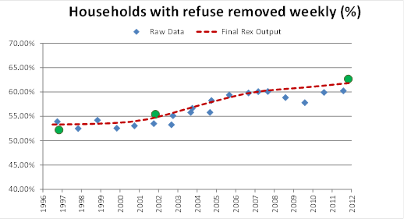
DATA:

Slide 16
RESULTS: Social Infrastructure
VARIABLE | C | SINF | RUDUM | SINFRU | R2 Adj | F-Stat
LGDPPC | 9.613 | 0.424 | 0.493 | -0.0182 | 0.483 | 1241.814
 |  | 46.634* | 18.245* | -9.736*
 |  | (0.000) | (0.000) | (0.088) |  | (0.000)
LHHDINC | 10.811 | 0.324 | 0.087 | -0.029 | 0.649 | 2450.014
 |  | 68.381* | 6.243* | -2.982*
 |  | (0.000) | (0.000) | (0.003) |  | (0.000)
LHDI | -0.697 | 0.120 | 0.110 | -0.044 | 0.692 | 2987..994
 |  | 73.937* | 22.892* | -13.258*
 |  | (0.000) | (0.000) | (0.000) |  | (0.000)
LPERPOV | -0.699 | -0.178 | -0.180 | 0.028 | 0.594 | 1994.743
 |  | -55.106* | -18.890* | 4.189
 |  | (0.000) | (0.000) | (000) |  | (0.000)
LPERLIT | -0.599 | 0.127 | 0.204 | -0.054 | 0.633 | 2288..308
 |  | 57.674* | 31.581* | -12.046
 |  | (0.000) | (0.000) | (000) |  | (0.000)

