Slide 1


Socio-Economic State of FS province:
Constraints to
Development and Competitiveness
Adaptation of paper presented at the CUT-curriculum conference in May 2010 by
IJ Moses
Chief Economist
Free State Provincial Treasury

Slide 2
Presentation Layout
Introduction
  Purpose
  Economic Analysis in Perspective
  7 + 1 key socio-economic challenges of the Free State
    Demographics
    Economy
    Labour
    Welfare and poverty
    Quality of life
  Conclusion
    Summary
    Challenges
    Responses

Slide 3
Economic Analysis in FSPT Context
MEC Finance
CEO
Administration
Asset & Liability
Sustainable Resource Management
Governance
Economic Analysis
Fiscal Policy
Budget Management
Public Finance

Slide 4
Core function…provision of budget-related research-based advice…
MEC
Economic Development Department
Economic Analysis
Needs & Policy Analysis
Fiscal Policy
Determine Fiscal Envelope
Budget Management
Budget Allocation
Public Finance
Monitor Implementation of Budget
Municipalities
EXCO
Planning Commission

Slide 5
Products/Services
Output/Service | Purpose | Frequency | How Far
SERO | Impact assessment | 5 years | Inaugural publication - 2008
PERO | Economic assessment | Annually | Inaugral publication – 2008
MTBPS | Fiscal Policy Analysis | Annually | Inaguaral publication – 2009
Newspaper Articles | Economic Literacy | Monthly | Since 2008
S3 of BS1 | Socio-economic state | Annually | Since 2007
QLMR | Labour Market Reviews | Quarterly | Since 2009
(Policy) Briefs | Briefings to MEC/EXCO | Quartely | Since 2010
Round Tables | Focused sectoral discussions | Annually | Since 2010

Slide 6
Introduction
Purpose
  Provide an overview of FS’s socio-economic challenges as evidence of our collective failure to use the resources and confidence placed on us to make this a better province;
  Combination of trend analysis and snapshots (1996 & 2007)
Data
  Secondary
  Major source - StatsSA
  Others
    Global Insight
    EMIS (Education Management Information System)
    HST (Health Systems Trust)

Slide 7
Challenge #1
A Province of missed opportunities….

Slide 8
Missed opportunities, is this tendency inherent? Can we afford to go on like this?
Centrality
  “located midway on the axis between Gauteng and Cape Town, traversed daily by national political and business leaders,...halfway to everywhere”- CDE Report (2005)
Commodity booms
  Economic transformation
Sasolburg?
  Linkages more in Gauteng
Rich history
  Founding place for ANC, NP & COPE
Excellent educational facilities
  Education hub – also catering for NC, Lesotho & parts of EC
2008 Recession
  Back to the drawing board….new solutions…
2010 FIFA World Cup
  3 000 additional seats to an existing stadium?
  “Guest-less” host city
  Upgraded airport..?

Slide 9
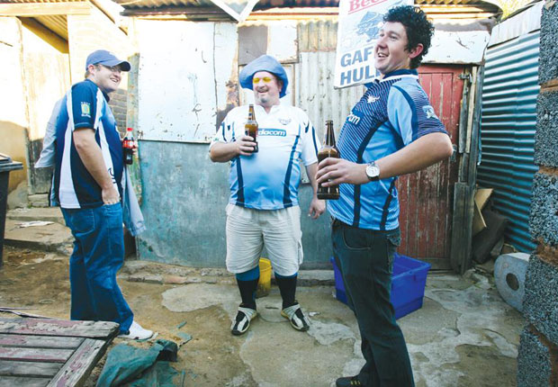
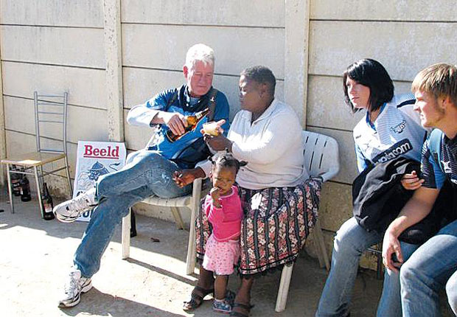
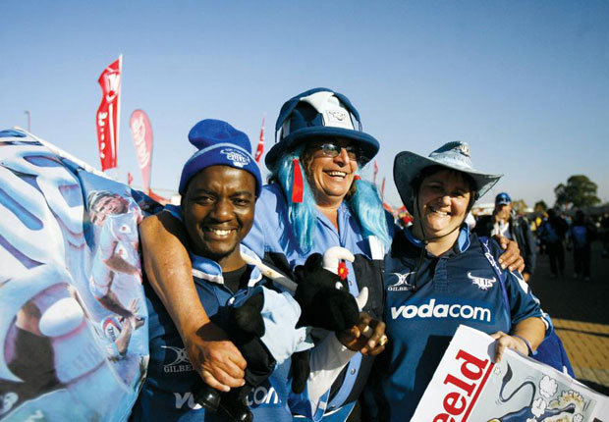

Too happy with status quo…..

Slide 10
Challenge #2
Small, slow growing young population in small towns

Slide 11
FS centrally located with population growing very slowly
2nd smallest population after Northern Cape
  1996 – 2.63 million (6.4% of total)
  2007 – 2.77 million (5.9% of total)
Average growth rate (1996-2007)
  SA = 1.2%; FS = 0.6% (well below replacement levels)
Gender composition
  1996 & 2007 – SA – female 51% & male 49% (ave); FS 49.7% male & 50.3% female
Race
  1996 –SA – 76.9% black, 11.8% white, ± 11.3% others;
    FS - 84.4% black, 12% white, ±3% others
  2007 – SA – 78.9% black, 10% white, ± 11.3% others
  FS 87.1% black, 9.6% white, ±3% others (white population declined by 49,000)
Urbanization – (Surprising, few major urban centres and a great deal of wide open space, dry and arid)
  1996 – SA = 54.2%; FS = 68.6%
  2007 – SA= 57.2%; FS = 79.2%

Slide 12
Proportion of school-going age cohort declining, proportion of working age increasing…..
Age Structure
 | 1996 |  | 2007
Age group | SA | FS | SA | FS
00-14 | 35.2% | 33.2% | 31.0% | 28.5%
15-34 | 35.6% | 36.1% | 36.1% | 36.1%
35-54 | 19.4% | 21.0% | 21.9% | 23.6%
55+ | 9.8% | 9.8% | 11.0% | 11.9%
Total | 100.0% | 100.0% | 100.0% | 100.0%
Old age home
High death rates (HIV-Aids-related) & migration
Low birth rate, combination of low fertility rates & high child mortality rates

Slide 13
Challenge #3
Small, poor performing economy reliant on government…...

Slide 14
2nd smallest economy, relative contribution to GDP declining (R91,7 billion in 2008)
Source: Stats SA, 2009

Slide 15
Poor performance in relation to target….6%?
IMF Projections
2010 - 2.6%
2011 – 3.6%
Sluggish recovery
Deeper recession

Slide 16
Challenge #4
High rates of unemployment, especially among African females…...

Slide 17
Unemployment in FS 3rd highest….

Slide 18
Government increasingly becoming employment agency or is it employer of choice?

Slide 19
Growing masses of the unemployed and discouraged….trend persistent
Free State Labour Market Indicators | Jan–Mar 2009 | Oct–Dec 2009 | Jan–Mar 2010 | Qtr-to-Qtr change | Year-on-Year change | Qtr-to-Qtr change | Year-on-Year change
 | Thousand | Thousand | Thousand | Thousand | Thousand | Per cent | Per cent
Population 15–64 yrs | 1 862 | 1 870 | 1 872 | 2 | 10 | 0.1 | 0.5
Labour force | 1 088 | 1 059 | 1 055 | -4 | -33 | -0.4 | -3
Employed | 812 | 790 | 768 | -22 | -44 | -2.8 | -5.4
Unemployed | 277 | 268 | 287 | 19 | 10 | 7.1 | 3.6
Not economically active | 774 | 811 | 817 | 6 | 43 | 0.7 | 5.6
Discouraged work-seekers | 83 | 101 | 102 | 1 | 19 | 1 | 22.9
Other | 691 | 711 | 715 | 4 | 24 | 0.6 | 3.5
Rates (%)
Unemployment rate | 25,4 | 25,3 | 27,2 | 1.9 | 1.8
Employed / population ratio (absorption) | 43,6 | 42,2 | 41,0 | -1.2 | -2.6
Labour force participation rate | 58,5 | 56,6 | 56,4 | -0.2 | -2.1
Free State Employment by Sector | Jan–Mar 2009 | Oct–Dec 2009 | Jan–Mar 2010 | Qtr-to-Qtr change | Year-on-Year change | Qtr-to-Qtr change | Year-on-Year change
 | Thousand | Thousand | Thousand | Thousand | Thousand | Per cent | Per cent
Agriculture | 89 | 74 | 75 | 1 | -14 | 1.4 | -15.7
Mining | 33 | 37 | 33 | -4 | 0 | -10.8 | 0
Manufacturing | 82 | 81 | 71 | -10 | -11 | -12.3 | -13.4
Utilities | 5 | 4 | 4 | 0 | -1 | 0 | -20
Construction | 65 | 56 | 45 | -11 | -20 | -19.6 | -30.8
Trade | 167 | 170 | 160 | -10 | -7 | -5.9 | -4.2
Transport | 38 | 44 | 45 | 1 | 7 | 2.3 | 18.4
Finance | 66 | 55 | 57 | 2 | -9 | 3.6 | -13.6
Community and social services | 172 | 169 | 189 | 20 | 17 | 11.8 | 9.9
Private households | 94 | 100 | 89 | -11 | -5 | -11 | -5.3
Source: Stats SA, 2009

Slide 20
Challenge #5
Low literacy and educational attainment levels .....

Slide 21
50% of LF in FS have completed Grade 9….need for skill development

Slide 22
Some explanatory factors….
Notes:
Unusual increase in learner numbers due to a variety of reasons, e.g. inclusion Grade R in schools, implementation of compulsory schooling age

Slide 23
Challenge #6
High poverty levels and rising inequality…...

Slide 24
Though falling, poverty levels remain extremely high…grants have become a vital source of relief
Between 2003 and 2007, households:
  with at least one grant recipient increased from 46.7% to 68.1%;
  with no grant recipient decreased from 53.3% to 31.9%;
  with at least one Child Support Grant recipient increased from 38.6% to 75.7%;
  with children aged 5-19 for which all children attend school increased from 77.5% to 85.5%.
The number of grant recipients rose from 93,757 people in 1994 to 747,262 people in 2007;
Expenditure on grants in the province rose from R800 million in 1995/06 to R3,7 billion in 2006/07.

Slide 25
Rising income inequality, average income of white household in FS now 5 times that of a black household
National average (2008) = R191,359

Slide 26
Further confirmation of worsening income inequality

Slide 27
Challenge #7
Inadequate access to basic services & infrastructure backlogs…...

Slide 28
Unbeknown to many, this is one area where the province performance is well above the rest, despite challenges at municipalities…

Slide 29
Challenge #8
Low quality of life.....

Slide 30
Quality of life in FS is 3rd highest and improving, BUT below national average….

Slide 31
Summary
Dwindling recorded population has adverse fiscal implications, but what is the extent of “unrecorded” population?
Economic recovery ongoing, but will take a bit longer to return to initial levels, what is it that is needed to accelerate recovery? What is the role of government in general and treasury specifically in economic growth?
Economic growth not sufficiently pro-poor, why? Is it structural or a reflection of a policy gap?
Not much improvement has happened over the past 15 yrs, is the time not ripe for a critical reflection? Is there a need to review the provincial allocation of resources? Can we dare be different or is compliance the name of the game?

Slide 32
Some Challenges
Inherent unavailability of data
  Time lag between actual event and the release of data too long
    GGP – quarterly data used to be available, but has been discontinued
    GDP – only quarterly data available, monthly data not available
    2010 FIFA WC statistics available end Sept 2010
Increased use of unofficial data
  Dearth of official data at sub-national level
  Unofficial not recognised (esp. by NT) for policy-making
  Different data suppliers, different models, different assumptions, different statistics
    Global Insight, Quantec & Barometer
Limited human & financial resources
  Small pool of economists with high turnover rate (No/Low return on public sector investment on capacity building)
  Non-personnel budget for research
    2% of Programme 2 = R1,3m out of R66,9m over MTEF
    8% of Economic Analysis = R1,3m out of R17,5m over MTEF
  Insufficient interest by local HEIs
Collaboration as opposed to Competition
  Duplication (meeting with StatsSA)
  Waste of resources

Slide 33
EA’s response to the challenges
Capacity-building
  TIPS CGE Training
  UP CGE Training
  Conningarth CBA Training
  DBSA/Conningarth SAM Training
Tools
  E-views
  Stata
  Rex
  CGE Model, in collaboration with UP
Research
  Funding Adequacy for Health
  Funding Adequacy for Education
  Pilot CGE-based studies
    Tourism
    Transport sector
  CGE-based study on impact of the recession in FS, in collaboration with FFC

Slide 34
Planned Studies
Project Title | Brief Description/Purpose | Mode | Implementation
Fiscal Implications of undocumented Migration in the Free State | Quantify the extent of undocumented migration and service delivery implications. Quantify the extent of under-funding from Equitable Share arsing from this anomaly. | Outsourced | 2010/11
Critical Success Factors for School Education in the Free State | Based on the Pareto Principle, identify key interventions in basic education in the province as well as the fiscal implications of such interventions. | Depend on outcome of roundtable | 2011/12
Utilization of new schools completed in the past 5 years in the Free State | Against the backdrop of declining learner numbers, research the utilization of newly completed/constructed schools in the past years. Should we still building new schools or should we upgrade existing facilities and concentrate on resource centres and laboratories? | Internal | 2010/11
Impact of the 2010 FIFA World Cup on the (economy?) Free State | Impact Assessment of the 2010 FIFA Soccer World Cup on Mangaung as host city and Free State province in general. | JV | 2011/12??
Critical Review of the Agricultural Sector in the Free State, including funding, CGE-modeling | With government’s commitment to revive agriculture in the Free State, use CGE modelling to quantify the amount of resources needed and the investment outcomes i.t.o output, employment and pro-poor income distribution. | JV | 2010/11
Employment/Job creation Survey | In preparation for the State of the Province Address, there might be a need to independently ascertain the number and types of jobs created for the preceding financial year so as to inform the following year’s target. | JV | 2011/12?
Impact of Land Reform on the economy of the Free State | The sustained decline in agricultural output, value-add and employment in FS has had serious impact on the poverty in the Free State. What has been the role of land reform in this? | Internal | 2010/11

Slide 35
Thank you!
mosesj@treasury.fs.gov.za
+27-51-405-5978

