Slide 1
Data, analysis, and scenarios from South Africa’s leading research and policy organization

Slide 2
^{About us}
The Unit for Risk Analysis is a specialist research team. It is housed within the South African Institute of Race Relations.
It builds on the Institute’s eight decades of research experience in South Africa to bring its subscribers the best data, analysis, and scenarios available on South Africa and data trends on more than 30 of Africa’s leading economies. By way of reports, briefings, and ad-hoc research support, the URA and the Institute today meet the information and intelligence requirements of over 300 businesses and organisations working in South Africa and Africa.
Fields of expertise include demographics, the economy, employment and incomes, business and labour, education, health and welfare, living conditions, communications, crime and security, and politics. The URA and the Institute produce in-depth reports, data, and scenarios around all these policy areas.

Slide 3
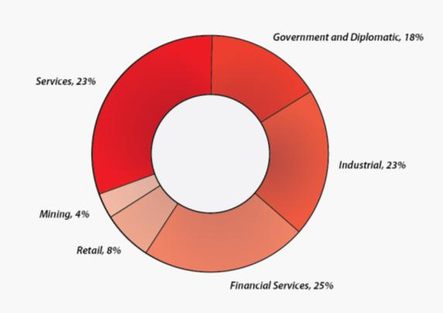
Subscribers are spread across the following fields:

Slide 4
^{Services}
Ad-hoc research support. Top-tier subscribers receive direct access to the research expertise of the Institute’s information centre, research team, and URA staff. Ad-hoc queries for data, advice, or policy dossiers are expertly handled . If the information you request is out there we will find it, saving you and your staff an immense amount of time and money.
Scenario briefings. The URA applies a widely-accepted scenario methodology to the Institute’s research outputs to produce cutting-edge briefings for its subscribers on how South Africa’s social, political, and economic future is likely to unfold. These briefings are routinely described as “eye-opening”, “brilliant”, or a “must see”.
Strategic briefings. The URA can brief your board, staff, exco, senior managers, or clients on all major policy areas in South Africa. There is no better or more direct briefing service available on South Africa.

Slide 5
^{Reports}
South Africa Survey. Published annually for 65 years the Survey updates trends across all the major policy areas covered by the Institute. The Survey runs to over 700 pages of data in hard copy and is also available online in both PDF and Excel formats. The Financial Mail has described it as “Essential research material, widely respected across the world”. Finance Week has called it a “Masterful Guide to the state of the nation”.
Africa Survey. An online supplement to the South Africa Survey tracking indicators for more than 30 of Africa’s leading economies.
Fast Facts. A monthly bulletin updating 170 social and economic indicators for South Africa. Fast Facts also features in-depth policy and legislative analysis. Annual editions include a budget review and a national skills overview. Fast Facts is available exclusively in electronic format. It is highly regarded in the corporate sector and has been described as “essential to understanding the politico-strategic environment”.
Occasional Reports. These range from political forecasts to in-depth assessments of significant policy areas.
Research and Policy Brief Papers. These short research papers are published on the Institute’s website and feature policy areas ranging from education to property rights to economic growth.

Slide 6
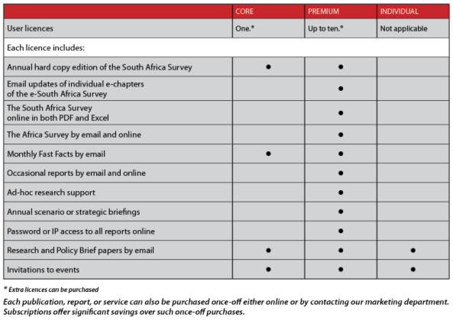
Subscriptions

Slide 7
“The reports and briefings of the Unit for Risk Analysis are an essential resource for any corporation that is serious about understanding South Africa’s rapidly evolving economic, social, and political environment.
These reports and briefings have been central to many of the strategic business decisions taken by Johnson and Johnson in South Africa.
There is no more complete, accurate, and detailed strategic planning resource available for the South African business community.”
^{Roger D. Crawford} Executive Director, Johnson and Johnson

Slide 8
^{Contact Us}
^{Sherwin van Blerk}
South African Institute of Race Relations / Unit for Risk Analysis
2 Clamart Rd, Richmond, Johannesburg, 2092
^{Tel: + 27 11 482 7221}
^{Cell: +27 82 851 5680}
^{sherwin@sairr.org.za}
^{www.sairr.org.za}

