Slide 1
Provincial
Economic Review and
Outlook
2011
Presented by: Bongi Mamba
Presented at the Annual Congress of the 3rd Public Sector Economists’ Forum
Date: 30 November 2011

Slide 2
Focus of the Presentation
Recent Global, National & WC economic performance and outlook
Economic structure and growth of the WC economy (output and employment growth and performance of sectors
The dynamics of the Western Cape labour market
A review of the WC socio-economic conditions

Slide 3
Global economic performance and outlook
After declining during 2009, global economic growth recovered robustly to 5.1 per cent during 2010.
Economic growth remained strong in the first quarter of 2011, but global economic conditions have since deteriorated
The International Monetary Fund (IMF) expects global output to grow by 4 per cent in both 2011 and 2012 (down from 4.3 and 4.5 per cent forecasted in June 2011).
For the US, the forecast for economic growth has been revised to 1.5 per cent in 2011 (1 percentage point lower than in June) and 1.8 per cent in 2012.
The Euro area has also been downwardly adjusted to 1.6 and 1.1 per cent for 2011 and 2012 (from 2.0 and 1.7 per cent previously).
The risks to global economic recovery remain ongoing fiscal difficulties in the US and Europe and high levels of unemployment in the former.

Slide 4
Risks to the global outlook
The key risk factor remains the fiscal sustainability of the US and parts of Europe, which should weigh on growth in those economies directly and on the global economy indirectly
The need for US fiscal consolidation has become more pronounced after Standard & Poor’s downgrade of US debt following a political standoff between the Democrats and the Republicans, which led to an 11th hour decision to raise the US debt ceiling
The European debt situation remains fundamental as Greece and others are forced to adhere to strict austerity measures in order to continuously access IMF/EU funding
Unemployment still remains high at 9.1 per cent and remains a concern. An improved job market in countries like the US is crucial if private demand is to counter the expected negative government contribution in 2012/13 as US fiscal policy starts to tighten.
The global economy remains at risk of a renewed oil price spike.

Slide 5
Developments in the SA Economy
Economic activity in SA registered growth of 2.8 per cent in 2010, following the decline of 1.7 per cent in 2009
GDP growth started strongly in 2010, with economic activity rising by 4.8 per cent in the first quarter of 2010
However, the middle part of the year saw a more modest pace of growth (around 2.8 per cent). The fourth quarter of 2010 again registered a robust rate of economic growth of 4.5 per cent.
The biggest contributors were manufacturing (contributing 0.7 percentage points), followed by the finance, real estate and business services as well as the government sectors (each contributing 0.4 percentage points).
Real consumer spending increased by an annual rate of 4.9 per cent during the second quarter of 2011, largely unchanged from the 5 per cent in the first quarter of 2011
Overall real fixed investment increased by 1 per cent q-o-q, which resulted in the year-on-year growth rate of 2.4 per cent, from 1.7 per cent during the first quarter of 2011.

Slide 6
Outlook for SA economy
The July PMI points towards continued strain on manufacturing production beyond the second quarter of 2011
National Treasury expects economic growth to accelerate to 3.1 per cent in 2011 and 3.4 and 4.1 per cent in 2012 and 2013 respectively.
In contrast to the National Treasury, BER expects growth to moderate to 2.8 per cent in 2012 before picking up to 3.6 per cent in 2013.
Headline SA consumer inflation remains on an upward trend, rising to 5.7 per cent year-on-year in September 2011 – the highest level since early 2010
The National Treasury expects CPI inflation to average 5 per cent in 2011 and to be slightly higher in 2012 at 5.4 per cent

Slide 7
Developments in the Western Cape Economy
Historically, the Western Cape economy has outperformed the national economy in terms of economic growth - finance, insurance, real estate and business services as well as the transport, storage and communication sectors
Western Cape economy, economic activity in the Western Cape declined by 1.4 per cent in 2009, which was slightly lower than the 1.5 per cent contraction registered by the national economy (at basic prices).
Regional GDP in the Western Cape grew at an average of 4.3 per cent per an
However, this average was pulled down by the 1.4 per cent contraction in economic activity registered in 2009

Slide 8
Western Cape GDP per sector: 2005 - 2010

Slide 9
Outlook for the Western Cape Economy
Description | 2011 | 2012 | 2013 | 2014 | 2015 | 5 year average growth
Agriculture, forestry & fishing | 3.1 | 2.0 | 2.7 | 3.3 | 3.5 | 2.9
Mining & quarrying | 4.4 | 1.0 | 0.9 | 1.1 | 1.1 | 1.7
Manufacturing | 3.5 | 3.5 | 3.5 | 3.6 | 3.4 | 3.5
Electricity, gas & water | 1.3 | 3.3 | 3.2 | 3.3 | 3.2 | 2.9
Construction | 2.1 | 5.0 | 6.2 | 6.5 | 6.7 | 5.3
Wholesale & retail trade, catering & accommodation | 4.2 | 3.7 | 4.1 | 4.0 | 4.0 | 4.0
Transport, storage & communication | 5.3 | 5.4 | 5.8 | 5.8 | 5.5 | 5.6
Finance, insurance, real estate & business services | 4.5 | 5.0 | 4.8 | 5.1 | 5.2 | 4.9
Community, social & personal services | 3.2 | 2.8 | 3.0 | 3.0 | 3.1 | 3.0
General government | 2.2 | 2.3 | 2.4 | 2.0 | 2.0 | 2.2
Total | 3.9 | 4.1 | 4.2 | 4.3 | 4.3 | 4.2

Slide 10
Western Cape real GDPR growth across 9 broad sectors: 2000 - 2010

Slide 11
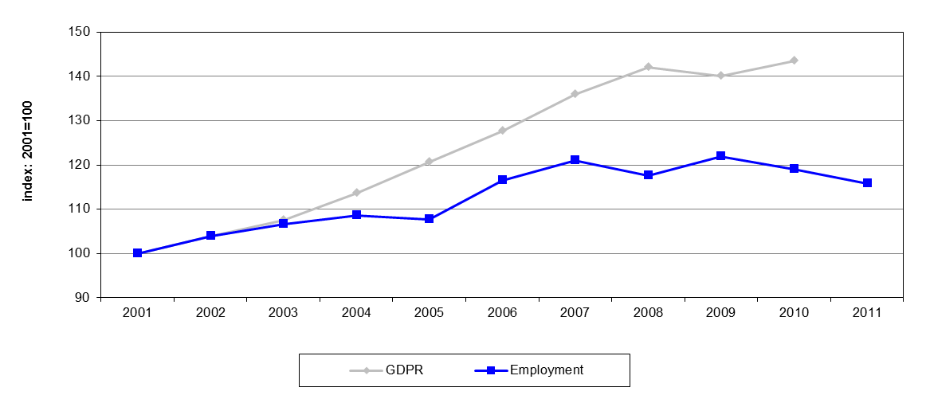
Western Cape: Real GDPR growth vs. Employment growth
There seems to be a link between the historical growth pattern and the structural imbalance in the Western Cape economy, specifically a mismatch between output and employment growth. The real economy expanded by close to 45% between 2001 and 2010, the regional workforce only grew by close to 16% over this period.

Slide 12
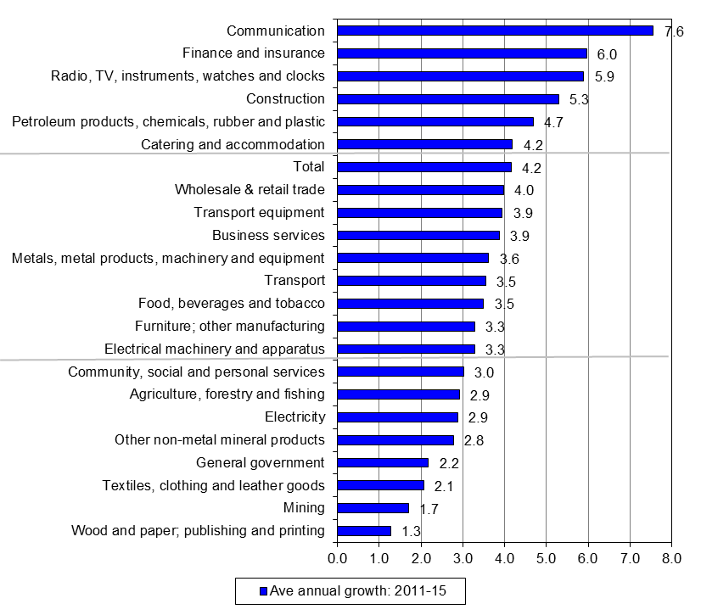
Western Cape sector outlook for real GDPR growth, 2011 - 2015

Slide 13
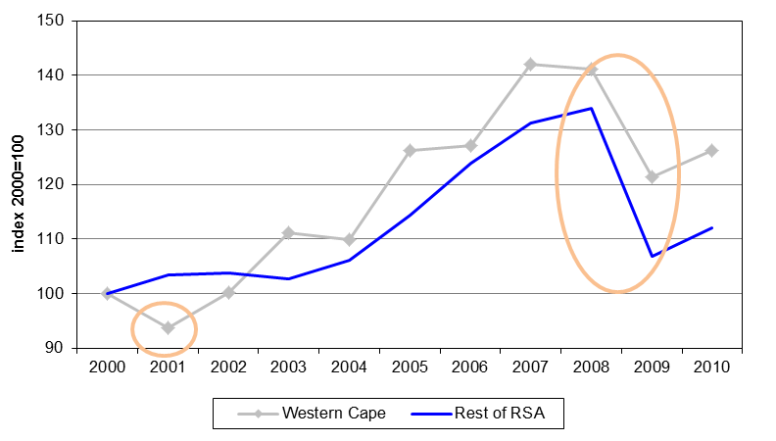
Real export growth: WC vs Rest of RSA, 2000- 2010

Slide 14
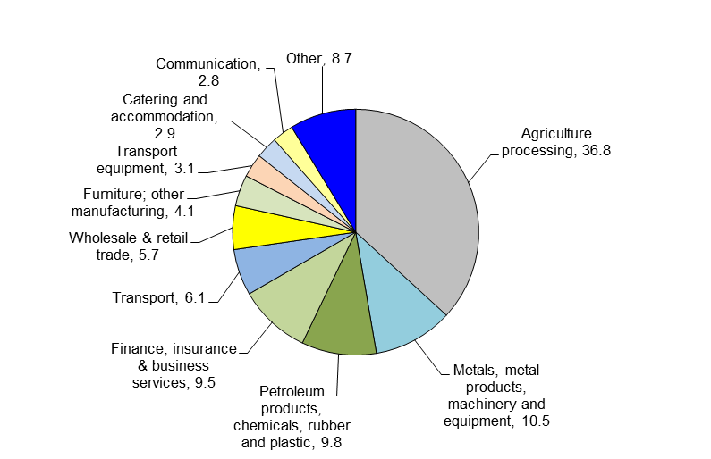
Composition of Western Cape exports: average, 2005 - 2010
Western Cape exports are dominated by the agricultural, forestry and fishing and food and beverage sectors, i.e. the food value chain. In all, these two subsectors accounted for approximately 37% of exports on average during 2005 to 2010.

Slide 15
Western Cape real export growth: 2011 - 2015

Slide 16
Overview of the Western Cape labour market, 2011
 | Working Age Population |  | Employed |  | Narrow Unemployed |  | Narrow Labour Force |  | Narrow Labour Force Partici­pation Rate | Narrow Unem­ployment Rate
 | Total (‘000s) | Share (%) | Total (‘000s) | Share (%) | Total (‘000s) | Share (%) | Total (‘000s) | Share (%) | (%) | (%)
Total | 3 450 | 100.0 | 1 789 | 100.0 | 510 | 100.0 | 2 300 | 100.0 | 66.7 | 22.2
By Race
African | 984 | 28.5 | 466 | 26.1 | 221 | 43.2 | 687 | 29.9 | 69.8 | 32.1
Coloured | 1 884 | 54.6 | 958 | 53.5 | 268 | 52.6 | 1 226 | 53.3 | 65.1 | 21.9
White | 568 | 16.5 | 355 | 19.8 | 21 | 4.2 | 376 | 16.4 | 66.2 | 5.6
By Gender
Male | 1 678 | 48.6 | 975 | 54.5 | 258 | 50.5 | 1 232 | 53.6 | 73.4 | 20.9
Female | 1 772 | 51.4 | 815 | 45.5 | 253 | 49.5 | 1 068 | 46.4 | 60.2 | 23.7
By Age Group
15 - 24 years | 882 | 25.6 | 196 | 10.9 | 168 | 32.8 | 363 | 15.8 | 41.2 | 46.2
25 - 34 years | 957 | 27.7 | 604 | 33.7 | 200 | 39.2 | 804 | 35.0 | 84.0 | 24.9
35 - 44 years | 743 | 21.5 | 522 | 29.2 | 98 | 19.3 | 620 | 27.0 | 83.5 | 15.8
45 - 54 years | 520 | 15.1 | 339 | 19.0 | 36 | 7.1 | 376 | 16.3 | 72.2 | 9.7
55 - 65 years | 348 | 10.1 | 128 | 7.2 | 8 | 1.6 | 136 | 5.9 | 39.2 | 5.9
By Education
No education | 44 | 1.3 | 18 | 1.0 | 1 | 0.1 | 19 | 0.8 | 43.5 | 3.9
Grades 0 - 7 | 479 | 13.9 | 194 | 10.9 | 81 | 15.8 | 275 | 11.9 | 57.3 | 29.3
Grades 8 - 11 | 1 447 | 41.9 | 601 | 33.6 | 268 | 52.5 | 869 | 37.8 | 60.0 | 30.8
Grade 12 | 931 | 27.0 | 545 | 30.5 | 135 | 26.4 | 680 | 29.6 | 73.0 | 19.8
Dipl/Cert | 292 | 8.5 | 234 | 13.1 | 15 | 3.0 | 250 | 10.9 | 85.5 | 6.2
Degree | 198 | 5.7 | 165 | 9.2 | 8 | 1.7 | 173 | 7.5 | 87.7 | 4.9

Slide 17
Recent Labour Market Trends, 2010Q3 to 2011Q3
 | 2010Q3 | 2010Q4 | 2011Q1 | 2011Q2 | 2011Q3 | Change
 |  |  |  |  |  | Absolute | Relative
Western Cape
Aggregates (Thousands)
Working Age Population | 3 390 | 3 403 | 3 417 | 3 430 | 3 444 | 54 | 1.6
Employment | 1 754 | 1 772 | 1 784 | 1 805 | 1 806 | 52 | 3.0
Narrow Unemployed | 527 | 498 | 510 | 504 | 550 | 23 | 4.4
Narrow Labour Force | 2 281 | 2 271 | 2 295 | 2 309 | 2 356 | 75 | 3.3
Broad Unemployed | 565 | 522 | 529 | 538 | 580 | 15 | 2.7
Broad Labour Force | 2 319 | 2 294 | 2 313 | 2 343 | 2 386 | 67 | 2.9
Discouraged Workseekers | 38 | 24 | 19 | 34 | 30 | -8 | -21.1
Rates (per cent)
Narrow Unemployment | 23.1 | 21.9 | 22.2 | 21.8 | 23.3 | 0.2 percentage points
Broad Unemployment | 24.4 | 22.8 | 22.9 | 23.0 | 24.3 | -0.1 percentage points
Narrow LFPR | 67.3 | 66.7 | 67.2 | 67.3 | 68.4 | 1.1 percentage points
Broad LFPR | 68.4 | 67.4 | 67.7 | 68.3 | 69.3 | 0.9 percentage points
South Africa
Aggregates (Thousands)
Working Age Population | 32 072 | 32 193 | 32 314 | 32 435 | 32 555 | 483 | 1.5
Employment | 12 975 | 13 132 | 13 118 | 13 125 | 13 318 | 343 | 2.6
Narrow Unemployed | 4 396 | 4 137 | 4 364 | 4 538 | 4 442 | 46 | 1.0
Narrow Labour Force | 17 371 | 17 269 | 17 482 | 17 663 | 17 760 | 389 | 2.2
Broad Unemployed | 6 429 | 6 287 | 6 587 | 6 745 | 6 646 | 217 | 3.4
Broad Labour Force | 19 404 | 19 419 | 19 705 | 19 870 | 19 964 | 560 | 2.9
Discouraged Workseekers | 2 033 | 2 150 | 2 223 | 2 207 | 2 204 | 171 | 8.4
Rates (per cent)
Narrow Unemployment | 25.3 | 24.0 | 25.0 | 25.7 | 25.0 | -0.3 percentage points
Broad Unemployment | 33.1 | 32.4 | 33.4 | 33.9 | 33.3 | 0.2 percentage points
Narrow LFPR | 54.2 | 53.6 | 54.1 | 54.5 | 54.6 | 0.4 percentage points
Broad LFPR | 60.5 | 60.3 | 61.0 | 61.3 | 61.3 | 0.8 percentage points

Slide 18
Industrial composition of formal employment
 | Western Cape |  |  | South Africa
 | Thousands | Per cent Share |  | Thousands | Per cent Share
Total Formal Employment | 1 485 | 100.0 |  | 9 743 | 100.0
Agriculture, forestry and fishing | 115 | 7.8 |  | 509 | 5.2 | †
Mining and quarrying | 2 | 0.2 |  | 306 | 3.1 | *
Primary Sector | 118 | 7.9 |  | 815 | 8.4
Manufacturing | 270 | 18.2 |  | 1 586 | 16.3
Electricity, gas and water | 11 | 0.7 |  | 96 | 1.0
Construction | 95 | 6.4 |  | 741 | 7.6
Secondary Sector | 376 | 25.3 |  | 2 422 | 24.9
Wholesale and retail trade | 306 | 20.6 |  | 1 941 | 19.9
Transport, storage and communication | 94 | 6.3 |  | 536 | 5.5
Financial and business services | 221 | 14.9 |  | 1 508 | 15.5
Community, social and personal (CSP) services | 369 | 24.8 |  | 2 516 | 25.8
Tertiary Sector | 991 | 66.7 |  | 6 501 | 66.7

Slide 19
Demographic characteristics of formal employment, 2011

Slide 20
Demographic composition of informal sector employment, 2011

Slide 21
Selected indicators of living standards within the Western Cape by region

Slide 22
Educational attainment of the South African adult population (20 years or more) by province, 2007

Slide 23
Western Cape infant and under 5 mortality rates, 2007 and 2008, and TB incidence by region, 2010

Slide 24
Transfers-in from outside the Province as a percentage of those in each grade, Western Cape 2010

Slide 25
Municipal Housing Backlog Estimate 2010

Slide 26
Percentage of households with access to four main municipal services, 2007 - 2009 and with all four services, 2001, 2007 and 2007 - 2009

Slide 27
Drug-related crime and Driving under the influence of alcohol or drugs in the Western Cape in a South African context between 2007 and 2011

Slide 28
Conclusion
The outlook for the global economy suggests that the recovery should continue in 2011 and 2012. However, recent economic have not been supportive of economic growth.
Agriculture and its associated processing industries are by far the largest contributor to Western Cape exports.
Employment remains stagnant, having changed little between 2008 and 2011. Coloureds account for 53 per cent of employment, with Africans and Whites accounting for 30 per cent and 16 per cent, respectively
The City of Cape Town dominates not only the economy but also the population of the Western Cape. Two-thirds of the population reside within the Cape Town Metropolitan area, while many more commute to work in the City on a daily basis.
Generally, socio-economic conditions in the Western Cape are better than in other provinces, although Gauteng has a somewhat higher educational attainment.

Slide 29
THANK YOU
THANK YOU

