Slide 1

Status Quo analysis of economic targets in LEDGP and NDP

Slide 2
Introduction
Provide analysis of economic growth, inequality and unemployment in LEGDP and NDP
Overview about implications of reaching targets in NDP by 2030 in Limpopo

Slide 3
Economic Growth
LEGDP target = 7,5%
NDP = average GDP growth rate of 5,4%

Slide 4
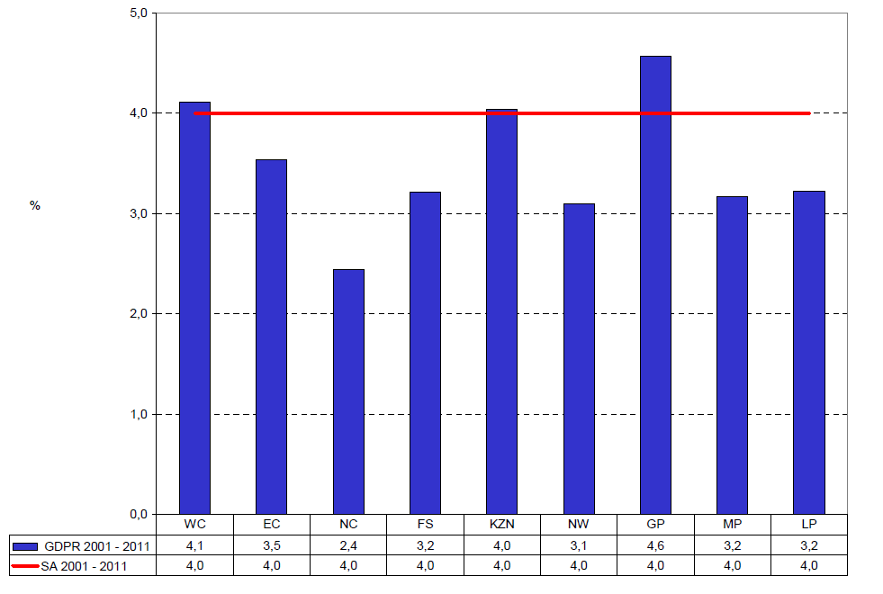
Economic Growth in Limpopo since 2001

Slide 5
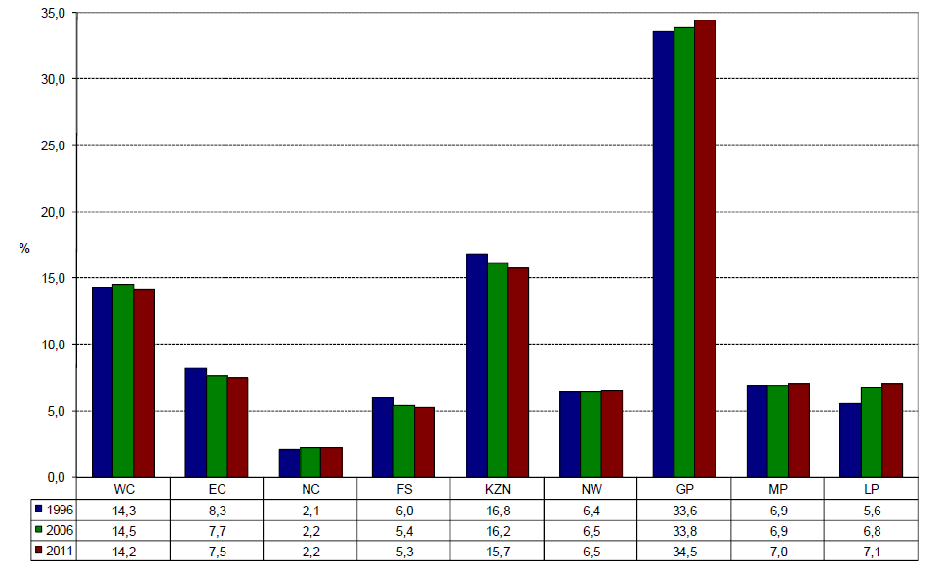
Contribution to the national economy

Slide 6
Analysis of growth potential
National economy

Slide 7
Historical SA growth performance

Slide 8
SA growth performance

Slide 9
Consumer price inflation

Slide 10
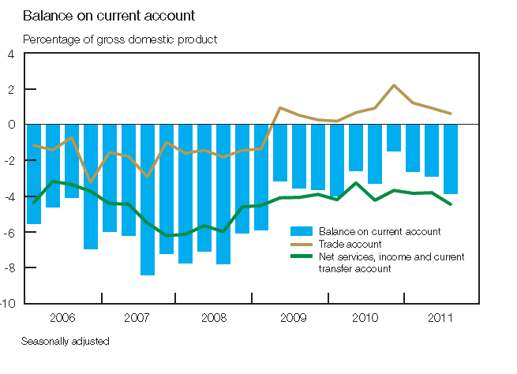
Balance on the Current account

Slide 11
SA growth constraint
Ceese Bruggemans – Long run growth 3 -3 ,5%
Will probably not even reach 3% this year
SA highly dependant on imports – BoP constraint
Skills crises. Schools not providing the skills needed for modern economy
Electricity and infrastructure constraints
Railways and harbours

Slide 12
Analysis of growth potential
Provincial economy

Slide 13
HP filter for Limpopo province

Slide 14
GDP per capita

Slide 15
GDP per capita
LEGDP
The LEGDP does not have a specific target for GDP per capita
NDP
GDP per capita to increase from R50 000 to R110 000 in constant prices

Slide 16
GDP per capita
 | 2006 | 2007 | 2008 | 2009 | 2010 | 2011
Real GDP [Millons) | 109 094 | 113 967 | 116 923 | 114 978 | 117 935 | 120 582
Population | 5 316 325 | 5 347 061 | 5 371 643 | 5 387 332 | 5 411 815 | 5 435 966
GDP per capita | 20 521 | 21 314 | 21 767 | 21 342 | 21 792 | 22 182
*Based on 2005 base year
Population numbers from Global Insight

Slide 17
Analysis
Limpopo GDP per capital much lower than NDP base value of R50 000
GDP per capita – 4,95 times increase to reach 2030 target
GDP to increase to R605 000 million
R26 912 million annual increase (average 9% pa)

Slide 18
Poverty
NDP target R418 per month reduced from 39% to 0 in 2030
Limpopo halving poverty before 2014

Slide 21
Inequality

Slide 22
Targets
LEGDP
No target was set for Inequality in the LEGDP
NDP
Overall Gini reduced from 0,7 to 0,6 by 2030.

Slide 23
Gini coefficient in Limpopo

Slide 24
Inequality in Limpopo
Gini already in target range of 0,6 -0,7
Well developed countries 0,4
Possible target 0,5

Slide 25
Unemployment

Slide 26
Targets
LEGDP target
To create 262000 jobs by 2014
To halve unemployment by 2014.
NDP Target
Reduce unemployment to 14 % in 2020 and 6% in 2030

Slide 27
Job creation – 2009-2013
2009 – 905000
2013 – 1092000
187000 jobs created

Slide 29
Analysis to reach NDP target
Unemployment rate 19,6% Dec 2012
Unemployed 266 000 out of labour force of 1358 000
Potential labour force 3 442 000
2084 000 not economically
330 000 discourage workers
Need additional 75880 jobs by December 2019
Need additional 184520 jobs by 2030
Assumptions very conservative

Slide 30
Access to basic services
LEGDP: no target
NDP - In 2030 all South African citizens will have affordable access to sufficient safe water and hygienic sanitation to live healthy and dignified lives.

Slide 31
Limpopo

Slide 32
Access to water

Slide 34
Conclusion
NDP targets could be achieved in Limpopo
Need correct policy measures
Do things differently to get different results
Need social dialogue to determine different roles of social partners

